Slide 1
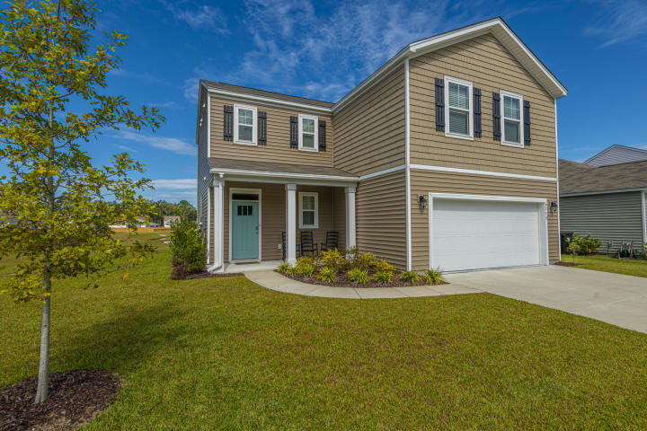
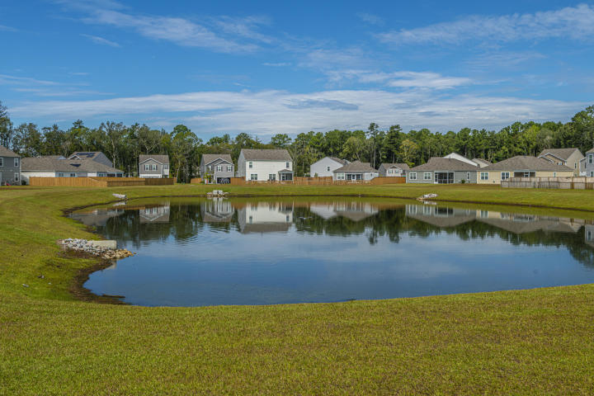
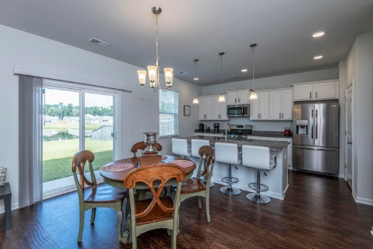
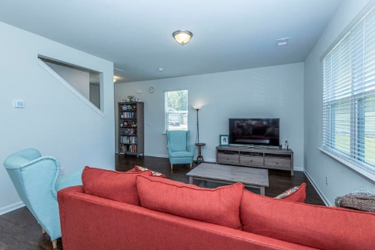
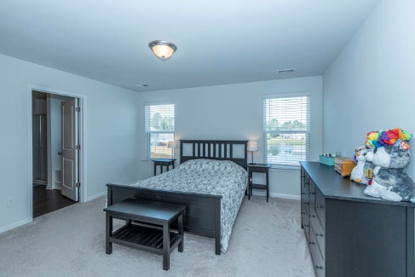
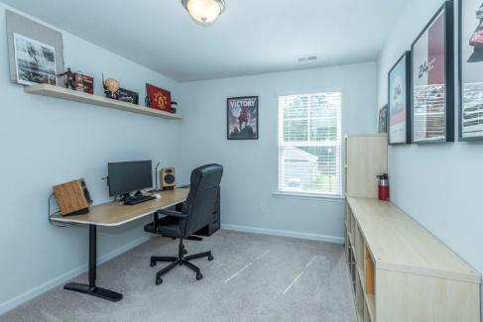
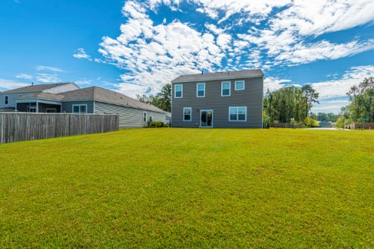
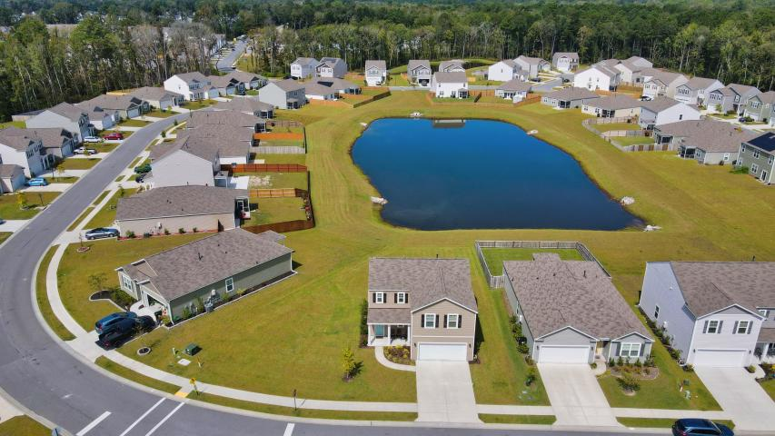



Why wait for new construction? This Park Circle area home is LESS THAN 2 YEARS!
New Listing! Look at This VIEW!
9732 Flooded Field Drive
Mckewn ~ Ladson, SC 29456 ~ MLS# 20026554 ~ $300,000
Do you want a house with a great view and a larger lot?! This is the one! Arguably one of the best properties in McKewn...this 4 bedroom, 2.5 bath house still has that new house smell to it. Add in that gorgeous pond view off the back and a double lot. Featuring brand new, resort-style amenities (pool, play park, indoor pickleball, soccer field, fire pit, outdoor kitchen), two entrances/exits & popular home plans catering to a variety of lifestyles, this neighborhood is a must visit! Schedule a showing quick in this market!
Virtual Tour: https://my.matterport.com/show/?m=d7df9eGGt4j
Del Shaffer
843.408.6821
dshaffer@carolinaoneplus.com
2713 Highway 17 North
Mt. Pleasant, SC 29466

