Slide 1

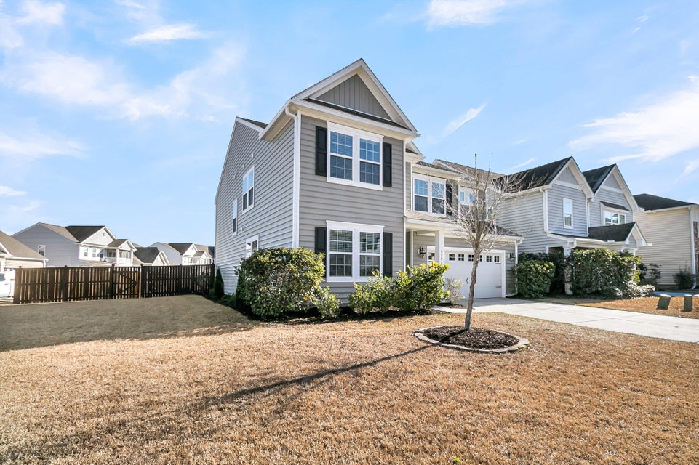
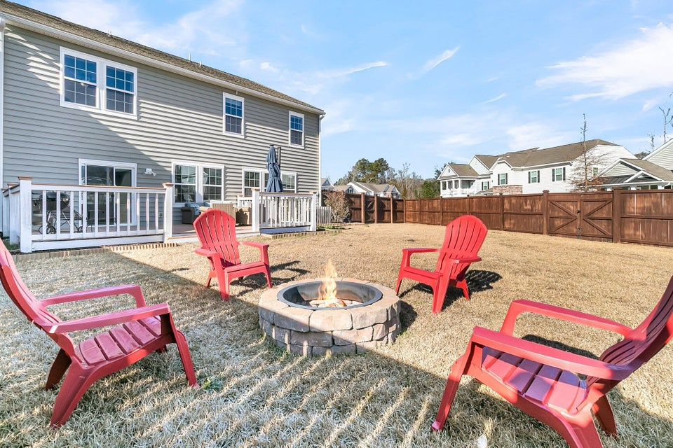
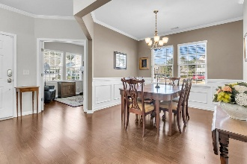
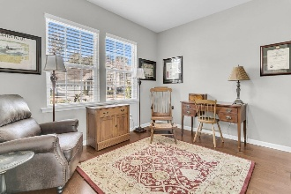
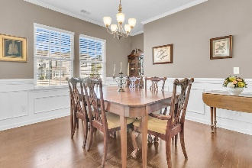
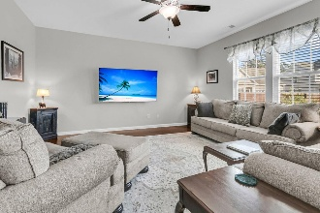
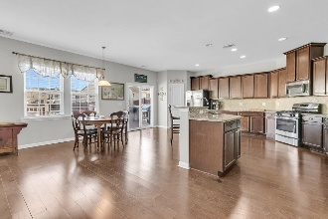

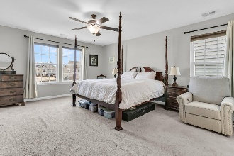
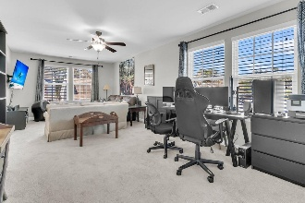
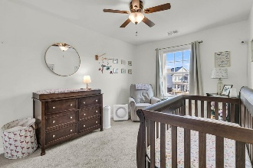
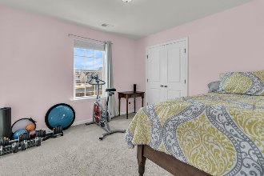
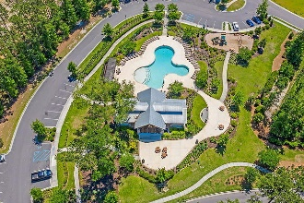
5 Bed/ 3.5 Bath Stunning Coosaw Preserve Opportunity!
Debbie Cromer
ABR, RSPS, REALTOR, CRS
(843) 437-6342
debbie@debbiecromer.com
www.debbiecromer.com
9736 Black Willow Lane
Coosaw Preserve | Ladson, SC 29456 | MLS# 25000722 | $525,000
Move-in ready & perfectly located on an oversized corner lot in the highly desirable Coosaw Preserve neighborhood, this 5-bedroom, 3.5-bathroom home offers a spacious open floor plan designed for entertaining & comfortable living. The main level features a private study w/ French doors, a separate dining room, & a large living room that flows seamlessly into the kitchen. The chef's kitchen boasts granite countertops, ample cabinet space, a stunning backsplash, pantry, gas stove, & a dishwasher. A large island w/ bar seating & an informal dining area make this space perfect for gatherings. Upstairs, you'll find the generously sized owner's suite w/ a private bath & walk-in closet, a massive bonus room (or 5th bedroom) w/ a Jack-&-Jill bath, three additional bedrooms, another full guest bath, & a convenient laundry room. Outside, the custom deck overlooks a fully fenced backyard featuring a double side gate & a fire pit, ideal for relaxing or entertaining.
Coosaw Preserve offers resort-style amenities, including a pool, clubhouse, playground, picnic pavilion, & an amenity center. Zoned for award-winning Dorchester II schools, this home provides the perfect combination of style, space, & location. Don't miss this opportunity...schedule your showing today!
TAKE A VIRTUAL TOUR
Century 21 Properties Plus | 1090 Park West Blvd; Ste 103 | Mount Pleasant, SC 29466

