Slide 1


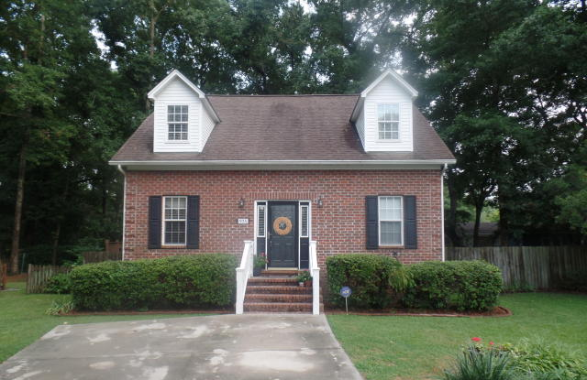
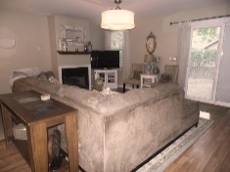

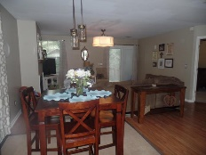
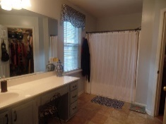
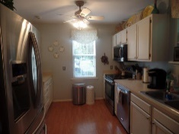
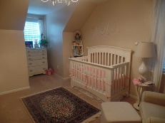

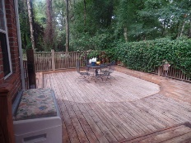
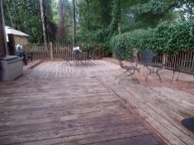
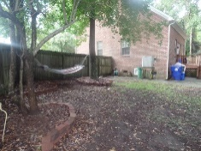
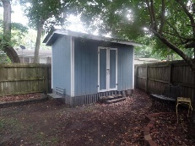

Cofa McCarthy
M (843) 568-0189
cjmcharlestonhomes@gmail.com
www.century21properties.com
Must See on James Island!
974 Stono River Dr | Riverland Crossing | Charleston | MLS# 15020465 | $275,000
RARE FIND ON JAMES ISLAND UNDER $300K!! NEW ROOF WITH 10YR WARRANTY AND 50YR SHINGLES INSTALLED 8/5/15!! Only 10 minutes to Folly Beach or downtown, and across the street from the James Island County park! This 3 BR, 2 1/2 bath brick home has been pre-inspected and is ready to move in! Updated kitchen featuring stainless steel appliances and refinished cabinets. New light fixtures, including a special order light in the main living area, fresh paint, floors and carpet only 5 years old going into upstairs bedrooms. Newly painted ceilings and a large storage area up stairs. Beautiful large deck in the back and also a brand new shed has been added to store all of the tools you need! Privacy fence along the perimeter of the house. Crawlspace was recently encapsulated to include a moisture barrier and ventilation system. Don't miss your chance to live on James Island in this highly sought out neighborhood. This one won't last long!
Century 21 Properties Plus | 2000 Sam Rittenberg Blvd #118 | Charleston, SC 29407

