Slide 1

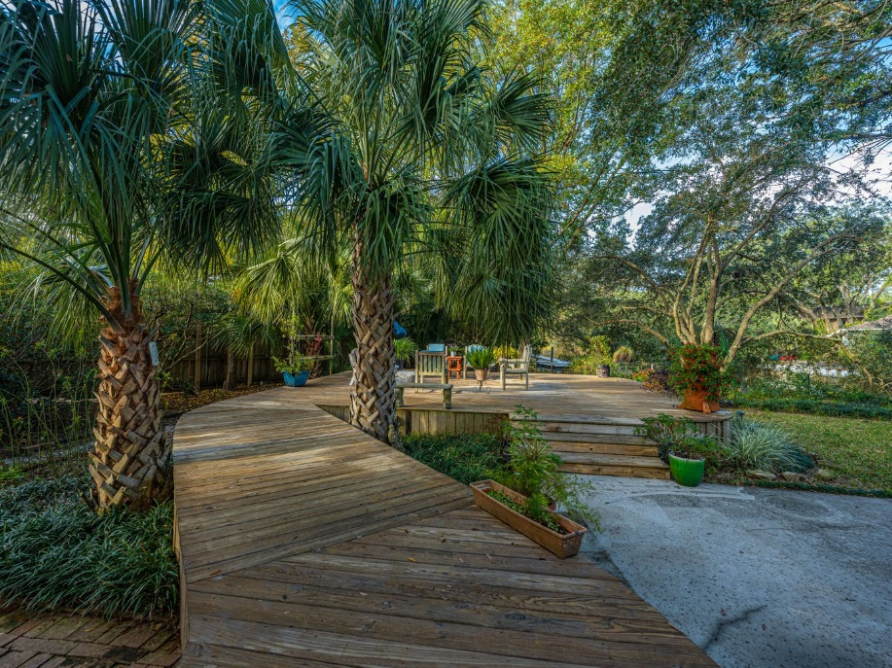
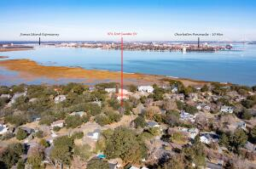








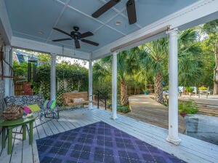


10 Minutes To Downtown
$25K Price Improvement!
974 Fort Sumter Drive
White Point | Charleston, SC 29412 | MLS# 22030667 | $1,250,000
Move-In ready! Amazing 4 bed, 3.5 bath, brick, traditional home on a TIDAL CREEK! This home is located in the desirable White Pointe Estates neighborhood and is only 10 minutes from downtown Charleston and 15 min. to the beach. You don't want to miss this opportunity! With gorgeous views of the tidal creek from all rooms on the back of the home, and a .68 acre lot with lush landscaping and massive trees, it is a peaceful, private oasis. The home has a nice flow from the foyer, which is flanked by a separate dining room on one side and a large living area on the other side that flows through to the family room and is open to the gourmet kitchen. The family room has a custom-built mantle and gas fireplace with sliding glass doors leading to the outdoor covered porch.
Adding to the charm, the wood flooring in the family room has been tenderly restored from a historic building on nearby Sullivan's Island.
If you enjoy entertaining, the outdoor space is incredible with a raised wooden walkway leading to a huge 24' x 28' ft. raised deck nestled among the trees overlooking the creek. In addition, there is an oversized patio as well.
This home has been lovingly maintained by the owners. The roof was replaced in 2020, and one HVAC in 2019. The windows have been replaced to Hurricane Impact and have a triple lifetime warranty which conveys to the next owner. There is also a water collection system and a lawn well. This is a great home, in a great neighborhood, in a great location!
Debbie Rogers
(843) 990-2915
deborah.rogers@carolinaone.com
www.DebbieRogersSellsCharleston.com
Carolina One Real Estate | 2713 Highway 17 North | Mt. Pleasant, SC 29466

