Slide 1
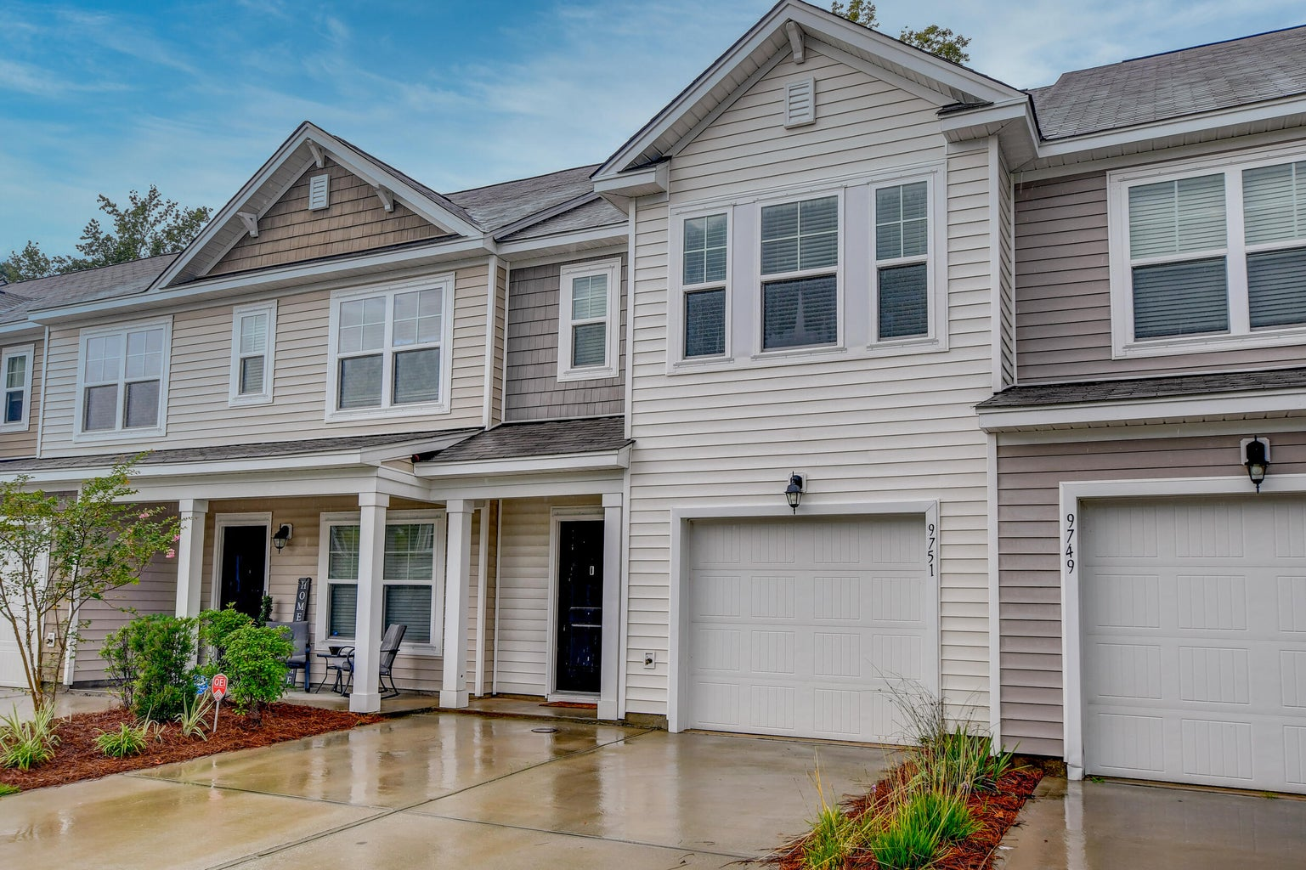

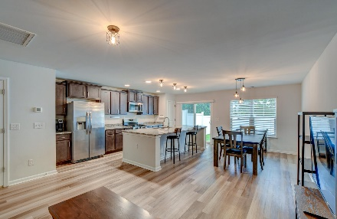
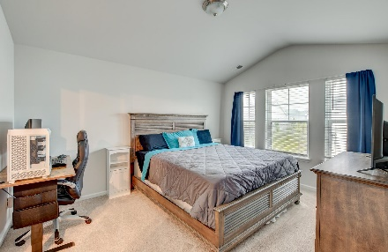
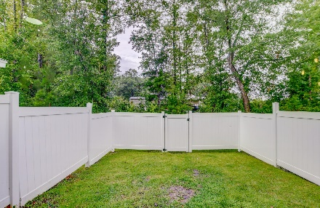
Price Improvement
9751 Transplanter Circle
Mckewn | Ladson, SC 29456 | MLS# 23016872 | $295,000
What a great find in Ladson! If you've been searching for a gorgeous townhouse, then this property located in the Mckewn community is a must-see! The exterior is welcoming and attractive as you approach the home. As you enter, you'll find the open living and dining area with access to the patio and fenced in backyard. The living room flows right into the beautiful kitchen with granite countertops, attractive cabinets, stainless steel appliances, an island, a pantry, and an eat-in area. Upstairs, you'll find the roomy owner's suite with vaulted ceilings, a walk-in closet, and an ensuite bath with a dual sink vanity and a large step-in tub. Two additional bedrooms and a full bathroom complete the second floor. This community features a pool, a playground, and often hosts food trucks.
This fantastic location is just 1.3 miles from Joseph Pye Elementary School, 5.4 miles from Trident Medical Center, 6 miles from Historic Downtown Summerville, and 10.4 miles from Charleston International Airport. Don't miss out!
Youlin Diaz-Duran ydiaz@mattoneillteam.com 570-337-1890

