Slide 1
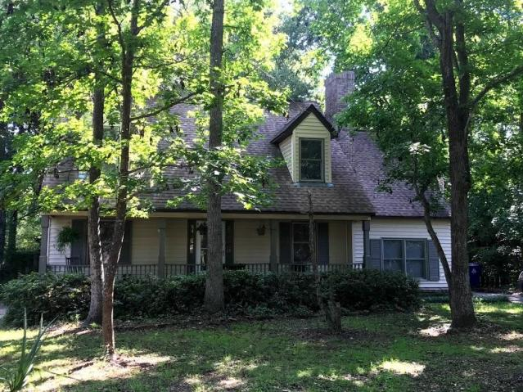
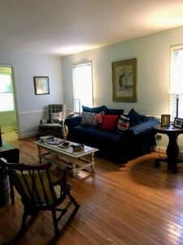
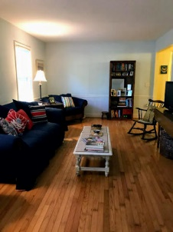
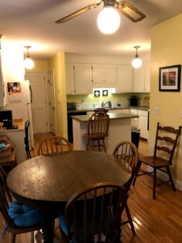
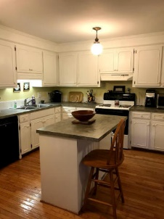
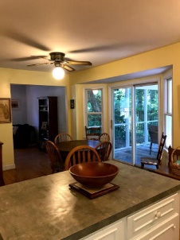
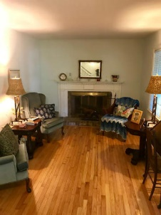
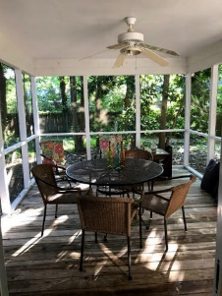



975 Colonial Drive
Snee Farm ~ Mount Pleasant, SC 29464
MLS# 18018580 ~ $368,000
1,785 Sq. Ft. | 3 Bed | 2 Bath
Reduced to $368,000
Agent Preview/Luncheon
Preview this great home before going live on MLS!
Wednesday, April 25th ~ 12:00-2:00
A great opportunity to get a cute, 3 bedroom, 3 bath home in highly sought-after Snee Farm Sub. Centrally located to everything. Minutes to Isle of Palms beaches, across the street from Towne Centre with over 60 stores for dining and shopping, and a short drive to downtown Charleston. Home has hardwood flooring downstairs, a screened porch and a large fenced backyard. Make it your dream home with some upgrades. A large, private lot with options to add onto the home or build a garage. Snee Farm offers memberships for golfing, swimming, social and tennis.
Jennifer Nipper, Realtor®
(843) 478-1800 | jen@AgentOwned.com
www.AgentOwned.com
The AgentOwned Realty Co | 824 Johnnie Dodds Blvd | Mt. Pleasant, SC 29464
Real Estate • Mortgage • Insurance

