Slide 1
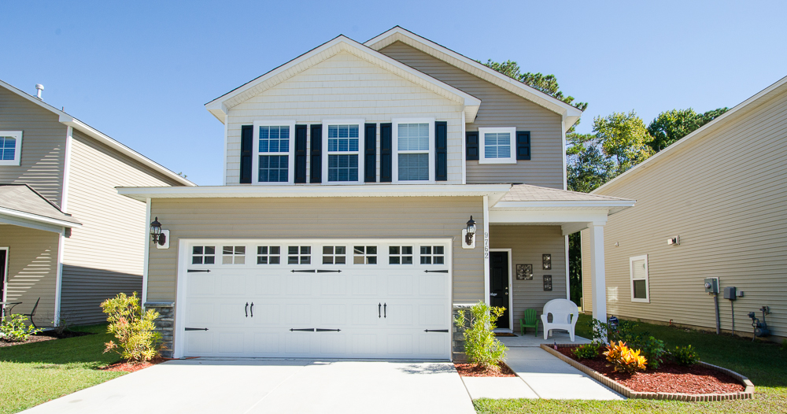
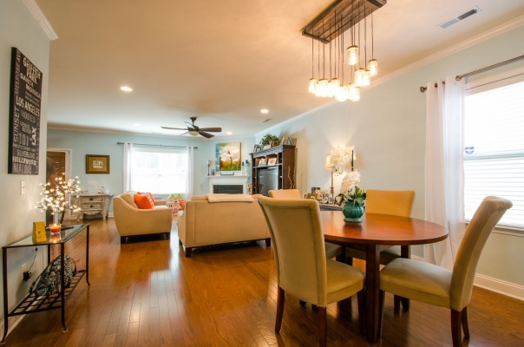
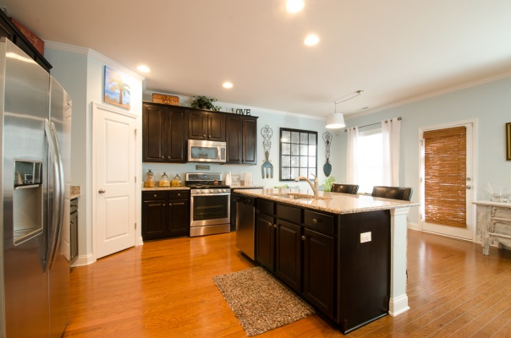
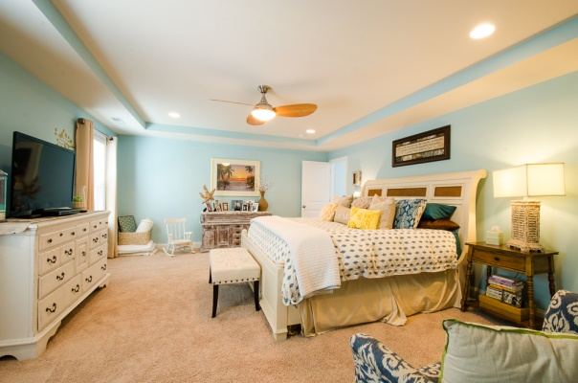
Open House This Saturday!
Nov. 16th from 12-3pm
~ 9762 Seed St ~ McKewn ~ MLS# 1326173 ~ $237,900 ~
Better than new and ready for immediate move-in! Impeccably maintained, beautiful 4 BR, 3 bath home with one of the most popular, open floorplans and well-appointed use of square footage. Literally every upgrade included in this home! Over $40,000 in upgrades including gorgeous wood floors throughout entire downstairs, expresso maple cabinets and detailed stonework on kitchen island, granite countertops, all stainless steel appliances including Whirlpool gas range, microwave, dishwasher and fridge all convey. Separate dining and eat-in kitchen area. Black granite fireplace with trim molding in family room. Programmable thermostats in both the downstairs and upstairs, security system, blinds and woven woods throughout the house, gorgeous ceiling fans and/or custom light fixtures in all rooms. Ceramic tile in all bathrooms and laundry room. Extra guest bedroom and bath located on the first floor. Upstairs you'll find a huge loft perfect for a study or playroom. Beautiful master bedroom with tray ceiling overlooking a private, wooded lot. Huge shower in master bath and a massive walk-in closet. Outside you can enjoy a screened porch overlooking a private wooded lot with a 6ft. privacy fence. Not to mention, a kid's dream playground set that conveys with the house! Also, this neighborhood is literally walking distance to award winning Dorchester II School District's Joseph Pye Elementary School, and conveniently located near I-26 and Dorchester Road for Boeing employees or Air Force personnel. READY FOR IMMEDIATE MOVE-IN! MAKE AN OFFER!
Kristin W. Abbate
843-200-6382
kristin@dcnrealestate.com
DIRECTIONS: Ladson Rd. to Palmetto Commerce Pky. 1.5m to traffic light, turn right onto Patriot Blvd, then right into McKewn. Or, Dorchester Rd to Wescott Blvd. Follow Wescott Blvd to stop sign, turn left Patriot Blvd. 1 mile to McKewn on Left. Right on Seed St.

