Slide 1
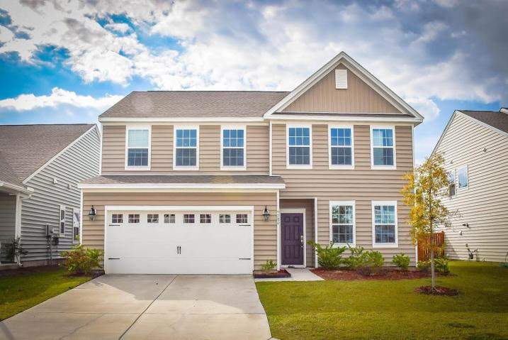
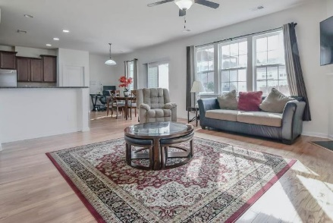
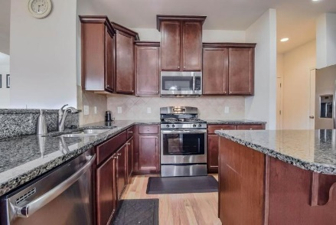
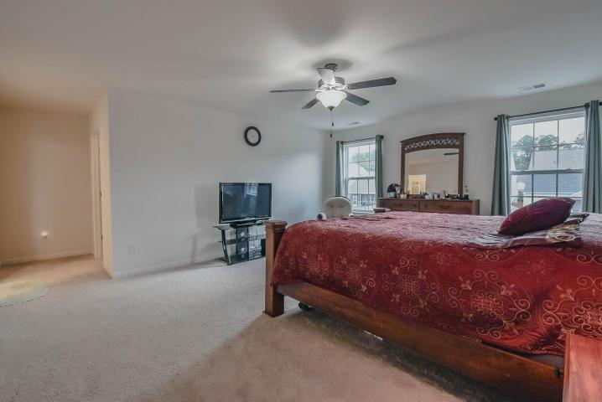
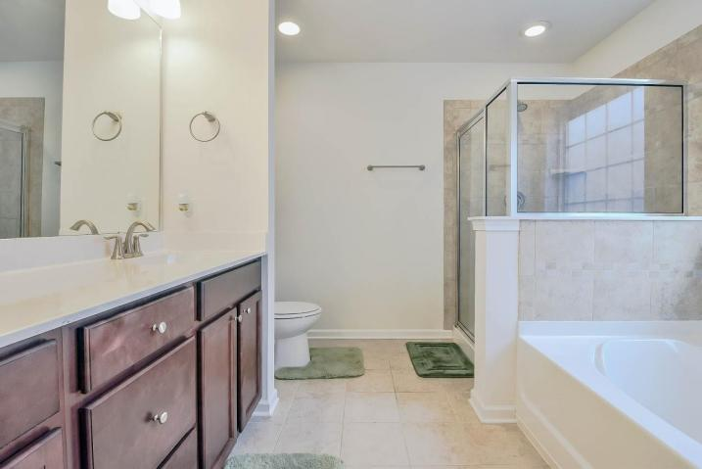
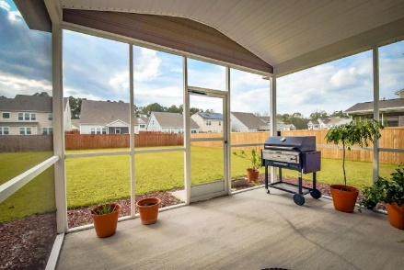
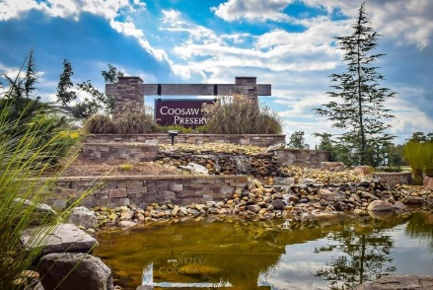
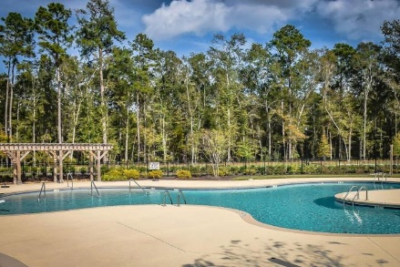


9780 Black Willow Lane Ladson, SC 29456 MLS# 17030226 $279,000
Premium Lot In Coosaw Preserve
Beautiful move in ready, one year old home. Over $14,000 in builder upgrades were added when seller purchased the home. The huge open concept kitchen features upgraded cabinets, large kitchen island, granite countertops, stainless steel appliances and gas range.
Living room contains a gas fireplace and opens into separate dining room. Upstairs features a large master bedroom/ensuite, 3 more bedrooms, full bath with ceramic tile floors, laundry room and loft space.
Mary Beth Bennett
(843) 367-1774
marybeth.bennett@agentownedrealty.com
www.chsarealiving.com
AgentOwned Preferred Group | 824 Johnnie Dodds Blvd | Mt Pleasant, SC 29464

