Slide 1
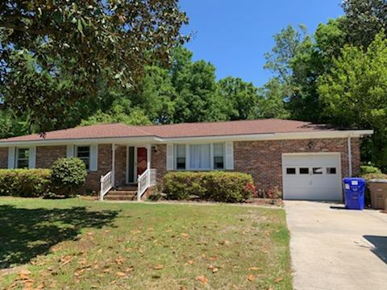
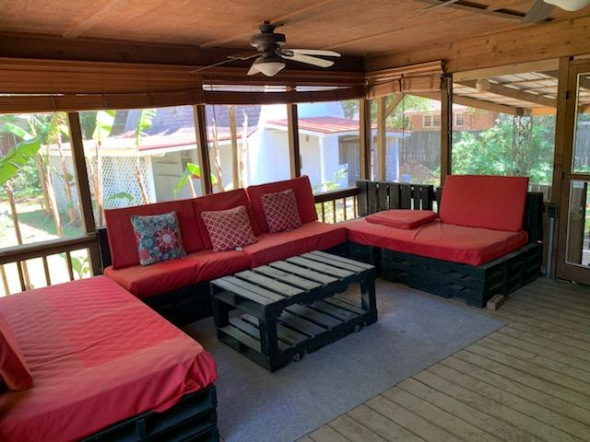
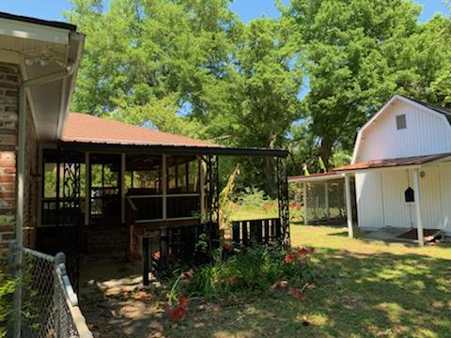
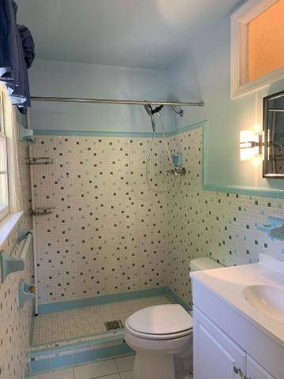
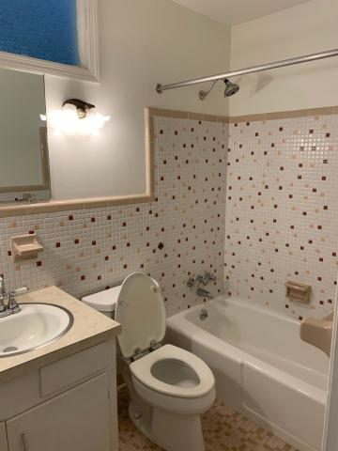

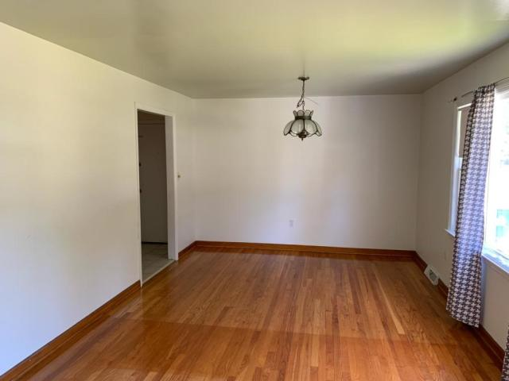
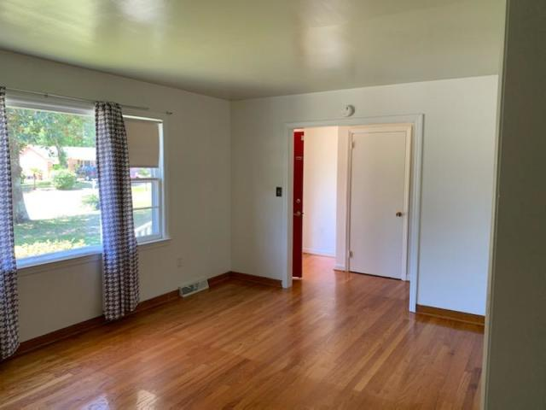
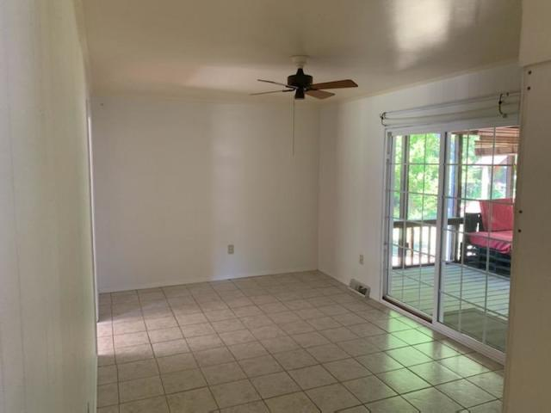

Great Location!
978 Mikell Drive
Stiles Point · Charleston, SC 29412
MLS# 20009970 · $325,000
Michael Dew
O 843-769-5100
M 843-870-7000
michaeledew@gmail.com
www.michaeldewrealestate.com
3 Bedroom 2 bath brick ranch on James Island. Hardwood floors through out. Fabulous screened in porch overlooking large fenced in back yard. Convenient to Folly Beach, down town, and shopping.
AgentOwned Charleston Group
902 Savannah Hwy
Charleston, SC 29407
Real Estate ● Mortgage Insurance ● Business Brokerage

