Slide 1


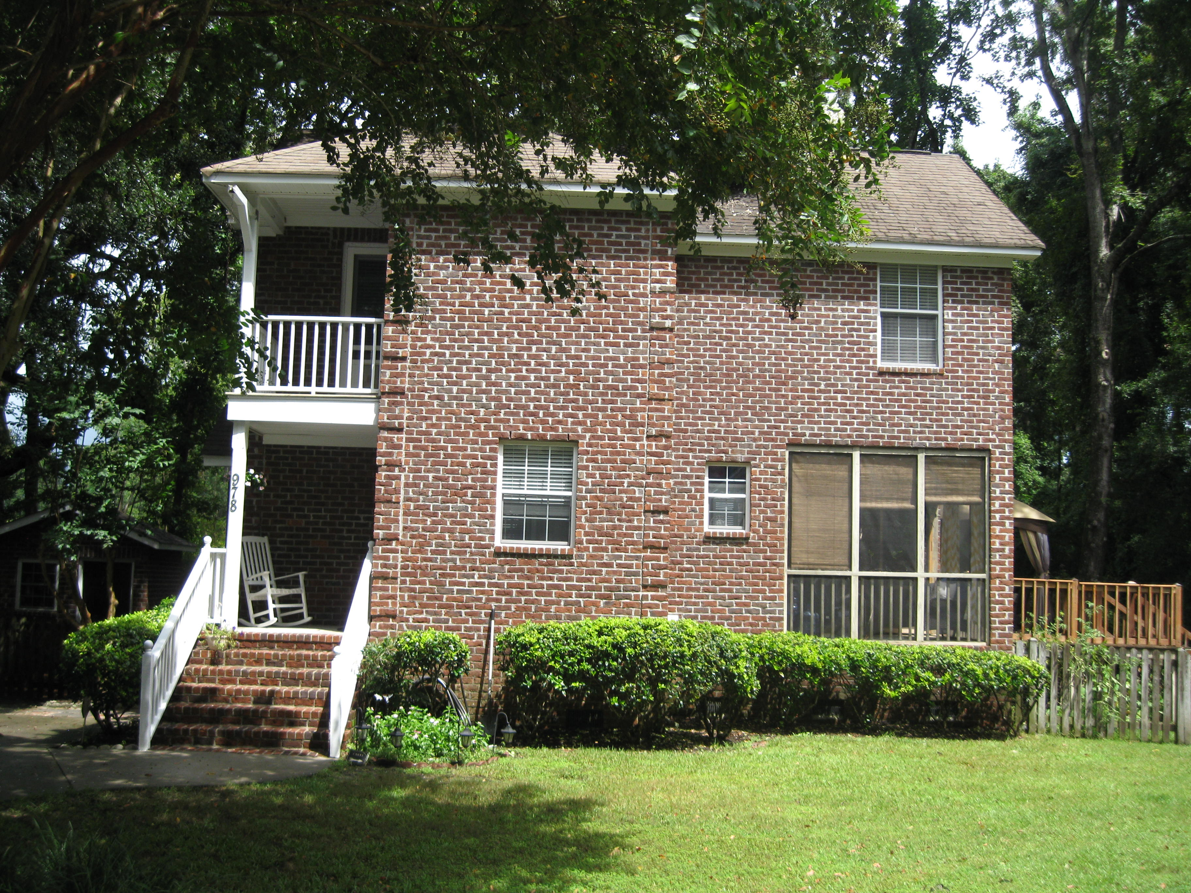
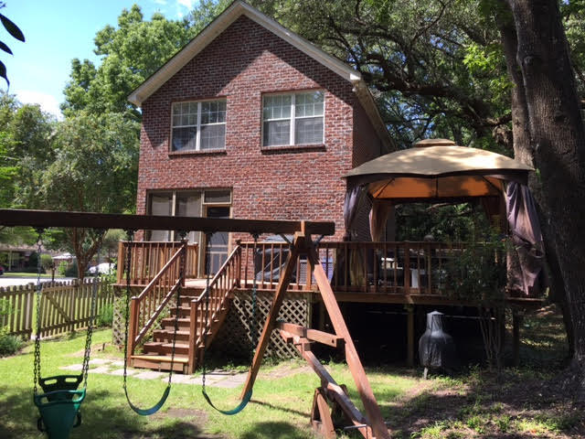
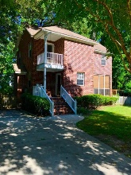
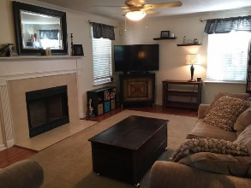
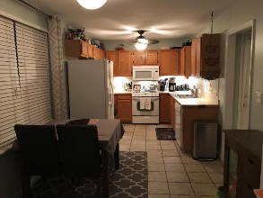
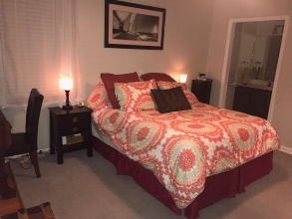
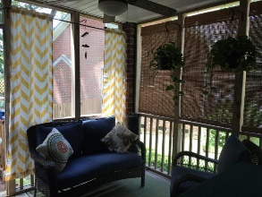
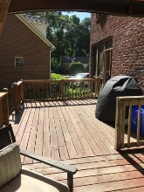
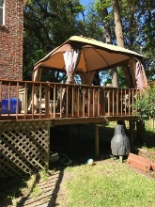
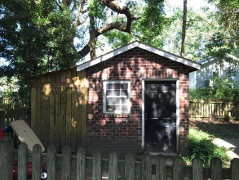


Rare Find On James Island!
978 Stono River Drive
Riverland Crossing - Charleston, SC 29412 - MLS# 17021828 - $329,900
This move-in ready adorable 3 bedroom house is nestled away on the cul-de-sac in a highly sought after neighborhood right off of Riverland Dr. This house has a screen porch and huge deck if you love entertaining and grilling out!
Updated bathroom vanities, freshly painted Kitchen and Master Bedroom, new upgraded door hardware and wood floors in the great room. Also, a gas fireplace with a mantle and a completely floored attic for tons of storage space!
The HVAC was replaced in 2010 and there is a shed with additional storage space off of it to keep things out of the rain.
It is located only 10 minutes to downtown and the beach and you don't want to miss your opportunity to be in this prime location in the heart of James Island!
Jan M. Miller, Broker Associate
jan.miller@goldenbearrealty.com
www.GoldenBearRealty.com
Golden Bear Realty | 654 Coleman Blvd, Suite 100 | Mt Pleasant , SC 29464
Cell (843) 345-9719 | Office (855) 352-9088 | Fax (561) 721-3311

