Slide 1
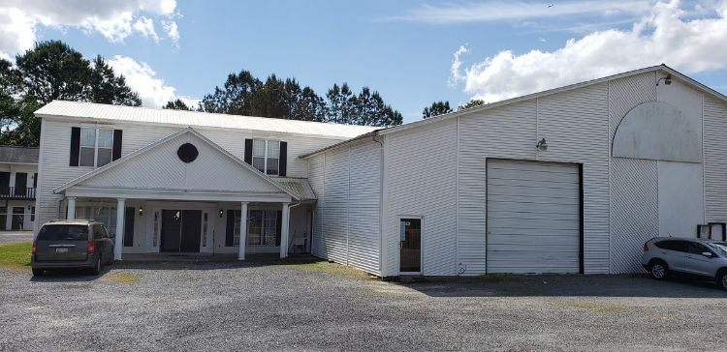
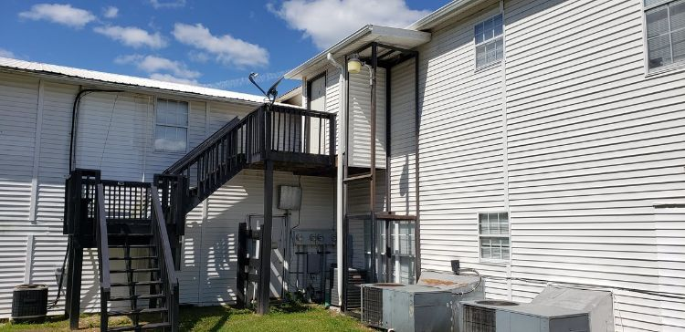
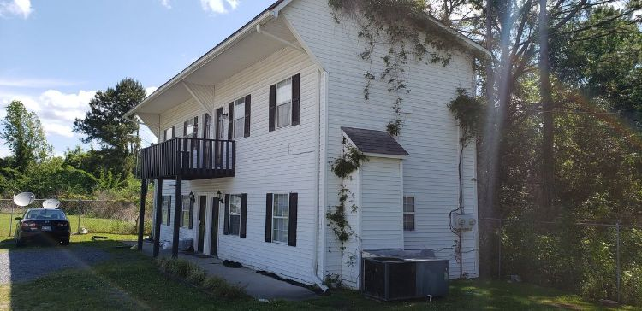
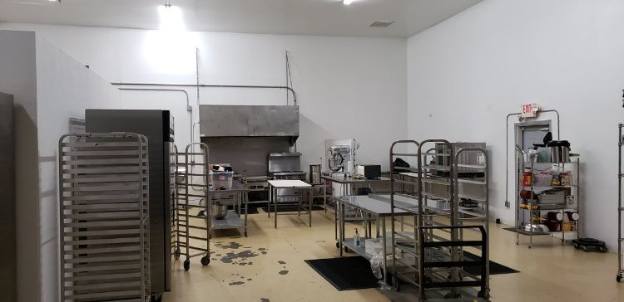
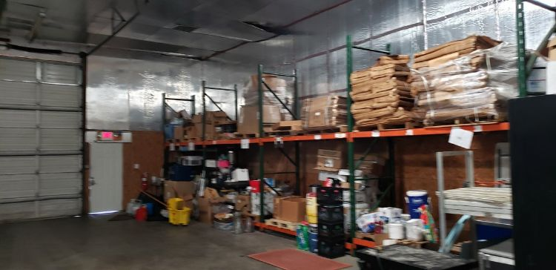



Why wait for new construction? This Park Circle area home is LESS THAN 2 YEARS!
Multi Family + Food Truck Kitchen!
978 S Live Oak Dr
Moncks Corner, SC, 29461 | MLS 30654347 | $950,000
This is a unique opportunity to own a 7 unit Multi Family property with an additional cash flowing business! This property is comprised of 2 buildings totaling 13400 SF. The main building is 11,550 SF and 5 apartments with great rental history and has an attached 4000 SF warehouse that is used as an FDA approved kitchen for food trucks that has 16 foot ceilings and two 14 foot roll up doors. The food truck business is in very high demand and the current owner is having to turn away business. The 2nd building is an 1850 SF townhouse with 2 apartments. The total gross income from the apartments is $63,002. The income from the FDA kitchens is $52,800 a year. There is additional warehouse space that is currently leased for $7,500 per year. There is an additional 1200 SF of space that could be leased as office space. The total income for the property is $128,952 Expenses include: Insurance, $9,053.14; Property Taxes, $10,526.90; Utilities, $ 14,360.73; Trash Pick up, $ 1,170.28; Total Expenses $30,433.77; Net Income $86,544.81. Restaurant equipment to convey with the sale is valued at $17,025.
Barnwell Cuthbert
(843) 509-9092
barnwell.cuthbert@carolinaone.com
191 Rutledge Ave
Charleston, SC 29403

