Slide 1
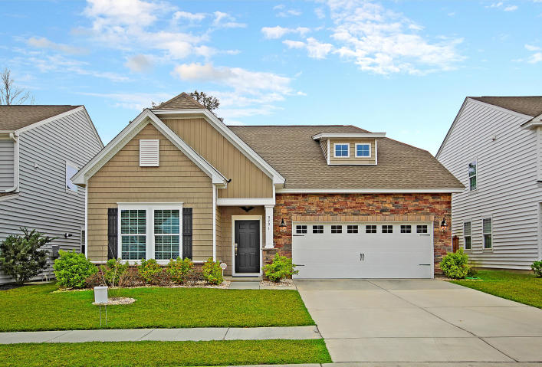
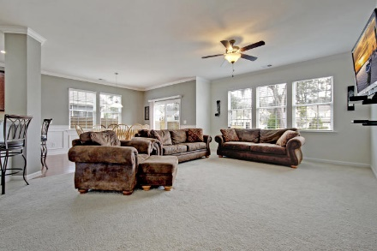
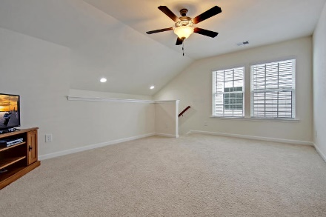
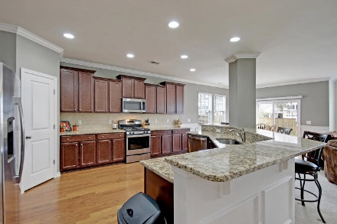
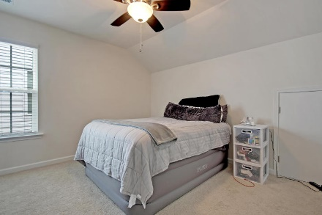
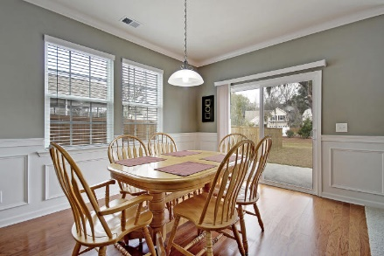
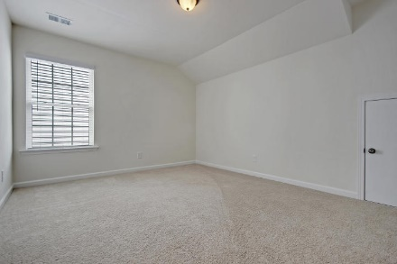
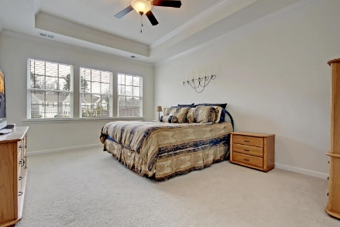
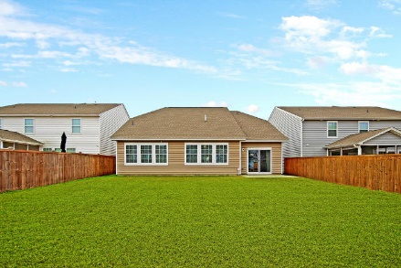
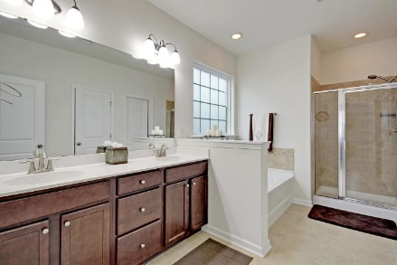
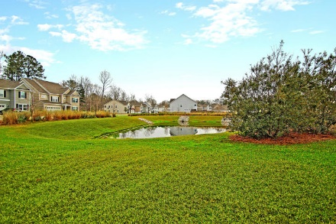
Price Reduced!
Open House ~ April 11th from 11a-1p
$25.00 gas card giveaway. Chicken Salad Chick lunch provided by Warren Armstrong of Fairway Mortgage
9791 Black Willow Lane Coosaw Preserve ~ Ladson, SC 29456 ~ MLS# 19006049 ~ $325,000
$25.00 GAS CARD GIVEAWAY Chicken Salad Chick lunch provided by Warren Armstrong of Fairway Mortgage
This home has been impeccably kept & is completely move-in ready! Walk through the doors into a spacious, flowing floor plan complete with hardwood floors, beautiful crown molding & picture frame wainscoting. The open concept kitchen features a large granite island with tons of seating that your friends and family will want to gather around. This is the ideal kitchen to cook & entertain. Just through the living room you will find a large, first floor master with even more lovely details...tray ceiling, large windows with gorgeous natural lighting, & more crown molding. The master bath is also lavish with it's deep bath tub, separate shower, & enormous walk in closet. Stroll outside into the backyard overlooking the pond. The backyard offers tons of privacy and is the perfect spot to unwind after a long day.
Additional features include:
Fantastic amenities including pool, playground, and picnic area.
Large den/office area.
Second Floor Bonus Area
4 spacious bedrooms.
Great location close to Boeing, and Charleston AFB.
Well maintained and move in ready!
Book your showing today!
Angela Miller angela@mattoneillteam.com 404-276-6355

