Slide 1
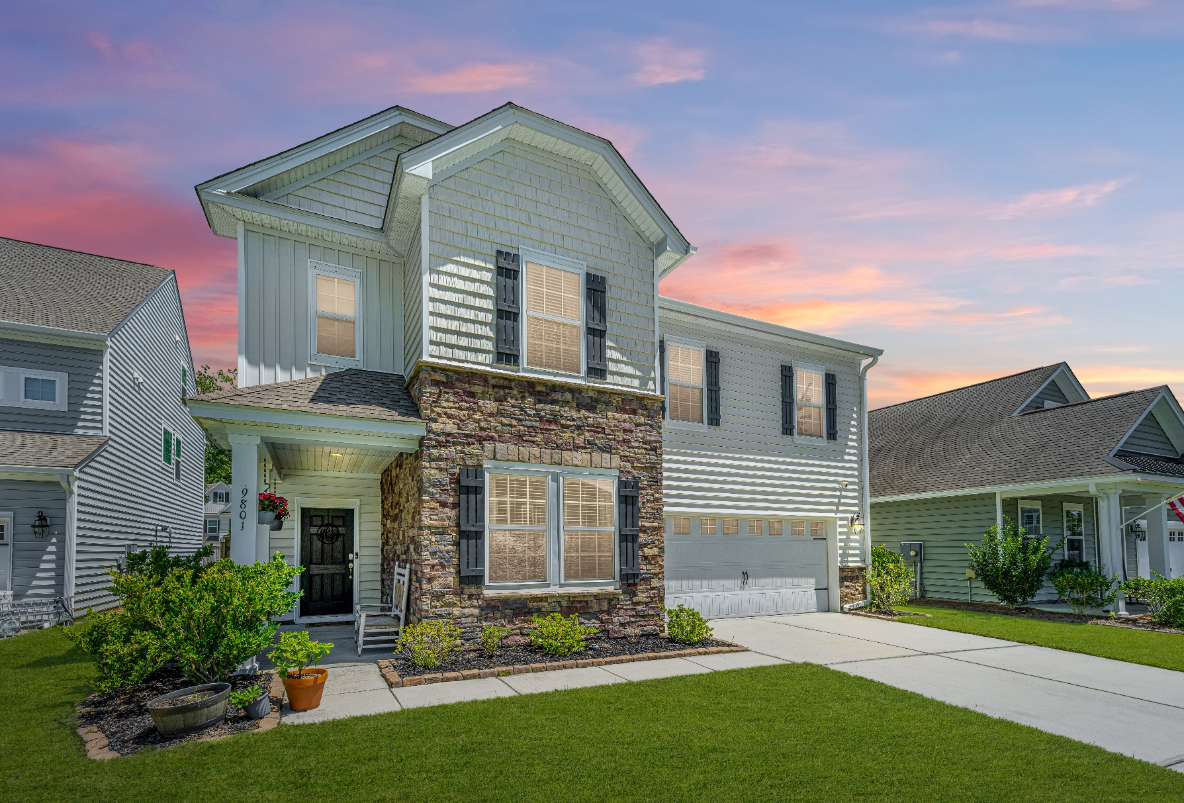
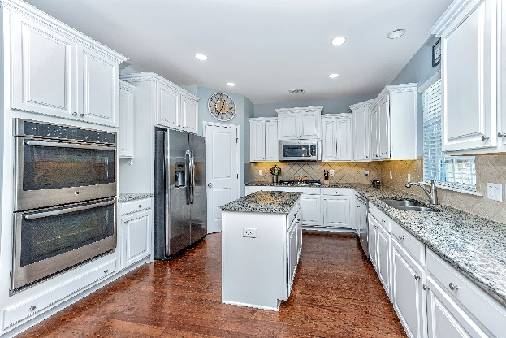
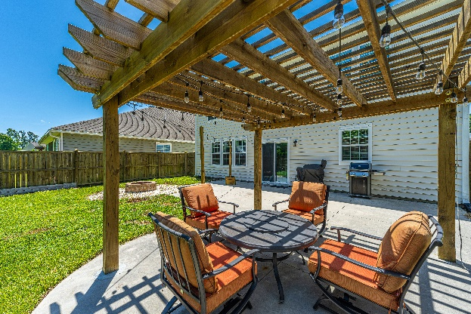
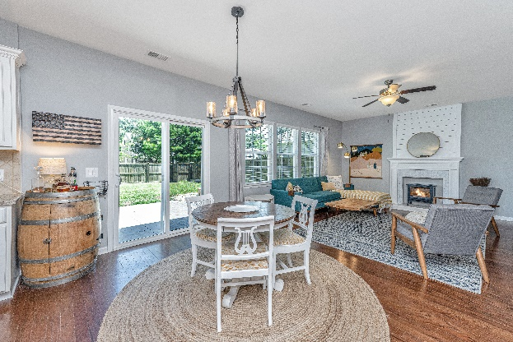
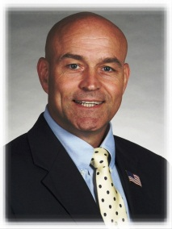

“Superb location, schools, & neighborhood!”
9801 Black Willow Ln
Ladson, SC 29456
Mid $400Ks
Open House Saturday
1:30PM-3:30PM, Hosted by Timme Spanos, 843-367-8025
Open House Sunday
1PM – 3PM, Hosted by Gina Sbertoli, 843-843-822-6275
Approx 2592 SF
4 BRs, 2.5Baths
Fresh, open floor plan
Looks & feels great; nice custom touches
Excellent back yard, pergola, patio
STEVE ROWE
,Realtor®
Retired Military. Active Agent.
(843) 303-7438
srowe@carolinaone.com
www.SteveRoweHomes.com

