Slide 1
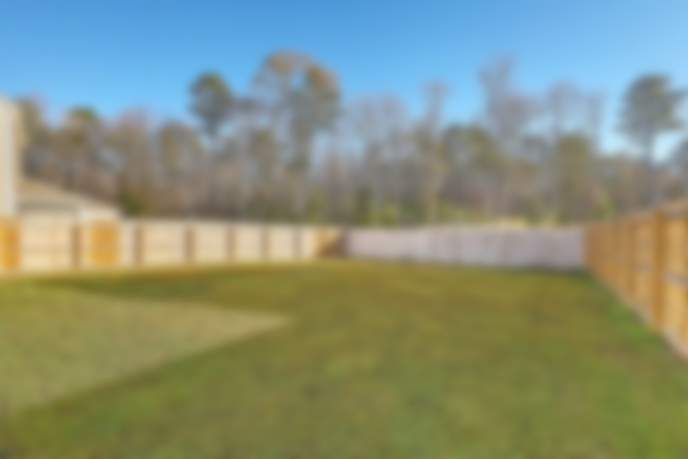
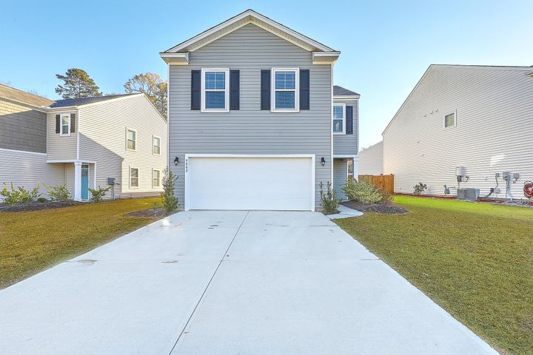
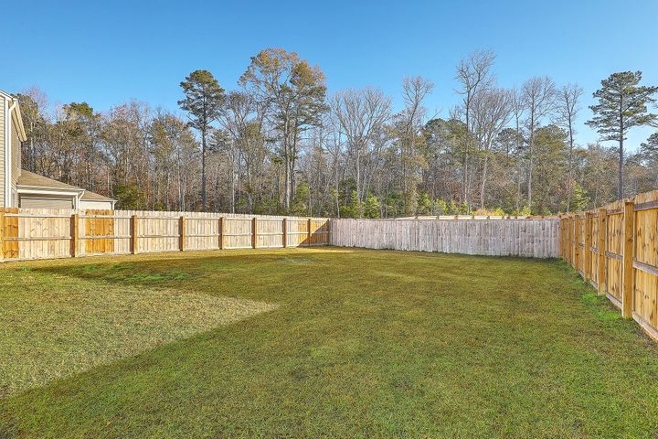
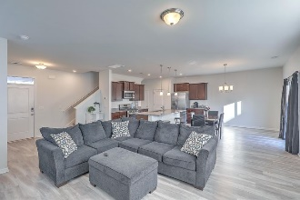
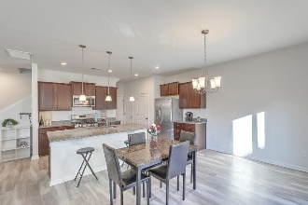
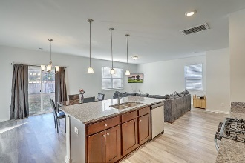
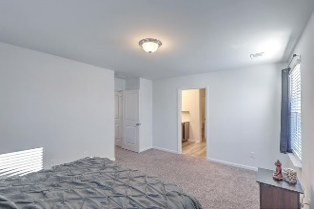
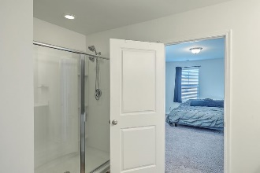
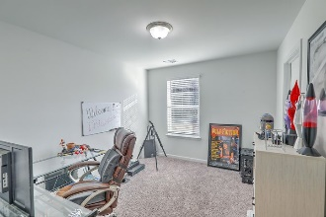
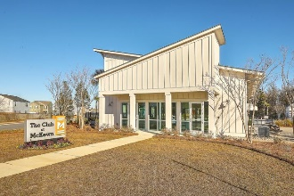
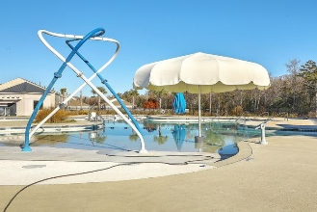
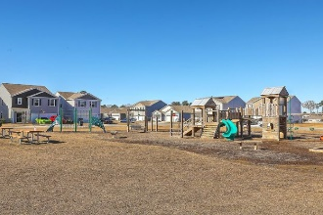
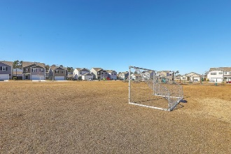


Open House Thursday 11a-2p
Check Out This Beautiful New Home
And Enjoy A Light Lunch
Open House Saturday & Sunday 11-2
9802 Wooden Pestle Way
Mckewn | Ladson, SC 29456 | MLS# 20033427 | $298,000
Almost Brand New!
This amazing 4 bedroom, 2.5 Bath home was newly built in 2019, situated on a Cul-de-sac. Located in the desirable community of McKewn! Conveniently located near shopping, dining, major roadways, and in the highly sought after Dorchester District II School District! ! As you enter you are met by tall ceilings, luxury vinyl plank flooring, and an open concept floor plan that is perfect for entertaining and everyday living! The kitchen is filled with beautiful cabinets and features granite countertops, recessed and pendant lighting, a pantry, stainless appliances, and a huge granite top center island with sink! Includes smart home technology. The master suite features a walk-in closet, and a large en suite bath with a dual vanity, oversized shower, and a water closet!
Video Tour: https://player.vimeo.com/video/494000604
Laura McLain
(843) 509-7647
laura@lauramclainrealty.com
The Boulevard Company, LLC
806 Johnnie Dodds Blvd Ste 100
Mt Pleasant, SC 29464

