Slide 1
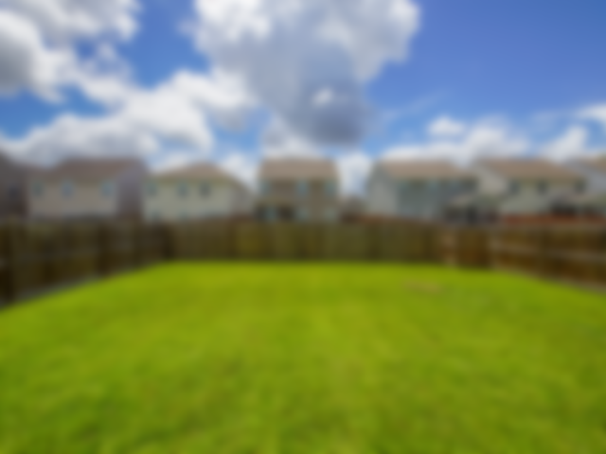
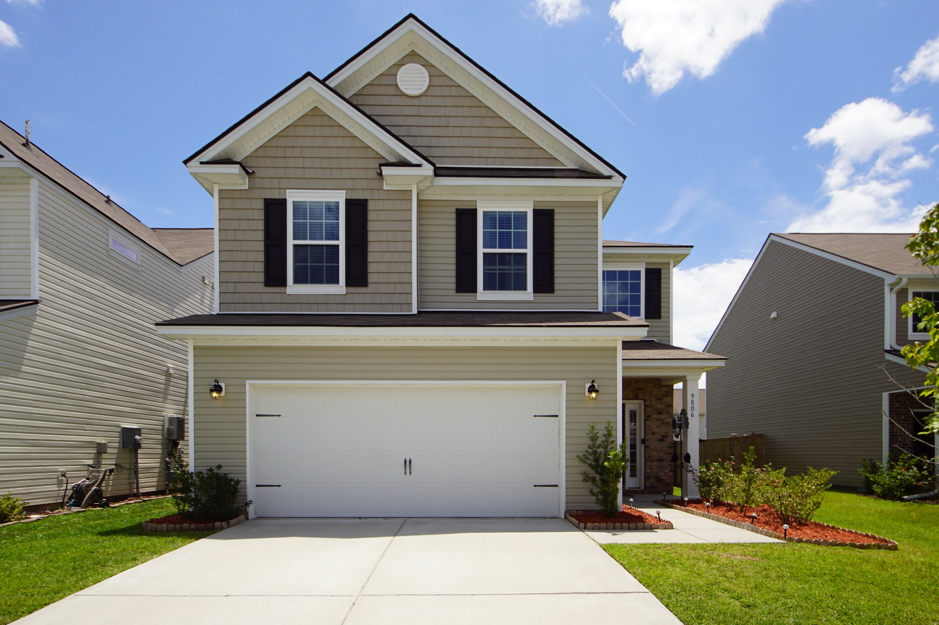
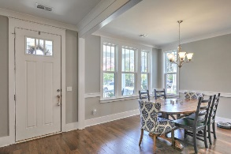
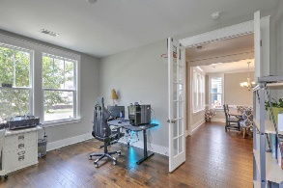
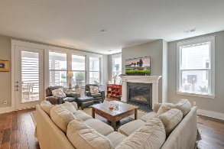
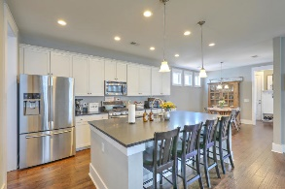
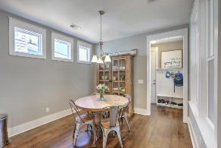
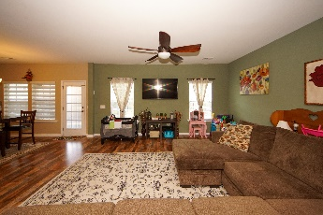
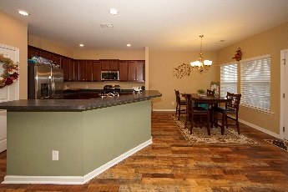
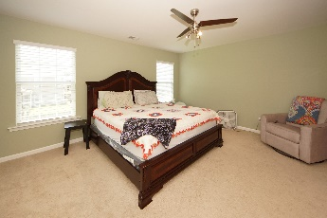
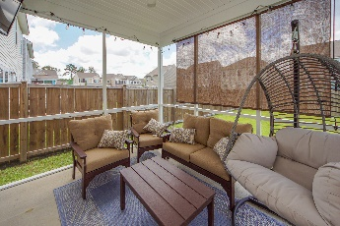
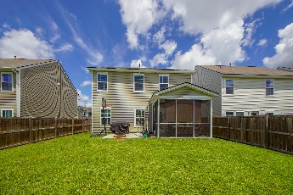

9806 Lone Cypress Lane Coosaw Preserve ~ Ladson, SC 29456 ~ MLS# 20021070 ~ $285,000
Bring All Offers!
Like New Home!
This like new home in coveted Coosaw Preserve is move in ready! It is centrally located to shopping and in the heart of the prized DD2 school district. Upon entering the home you are greeted by beautiful floating hardwood floors and an abundance of natural light. The spacious downstairs living area features an eat in dining space, modern kitchen, and large family room. The kitchen features energy efficient GE appliances and is flanked by a half guest bath. Upstairs there are three substantial bedrooms with a large shared bath and a loft area, perfect for exercise equipment or indoor play area! Also upstairs is the laundry room and lovely master bedroom/bath, complete with a walk in closet. Off the back of the home is a screened in porch with cable television connection as well as a patio.
Matterport Tour: http://www.charlestonvirtualhomes.com/2200356
Chris Phillips
(843) 446-9199
chris.phillips@cbcarolinas.com
www. cbcarolinas.com
Coldwell Banker Residential Brokerage
4969 Centre Pointe Dr
Suite 203
Charleston, SC 29418

