Slide 1
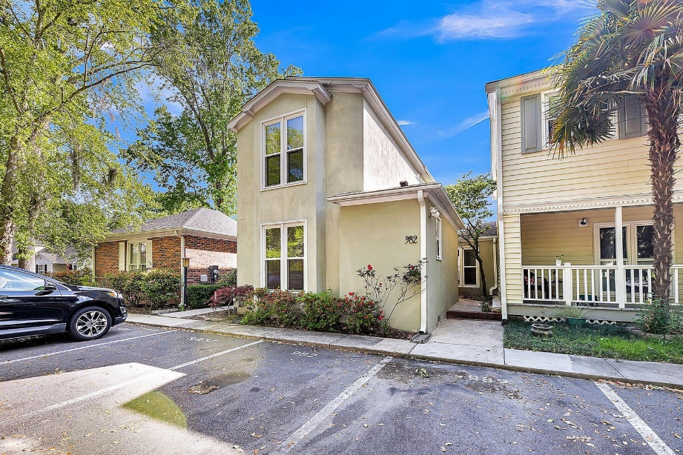
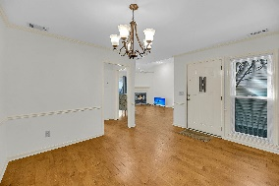
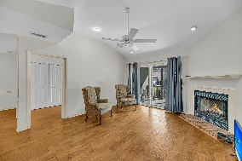
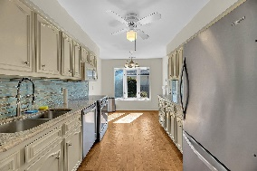
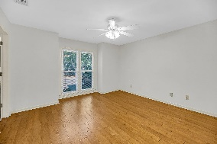
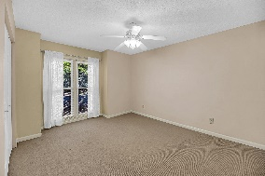
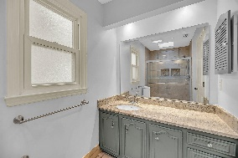
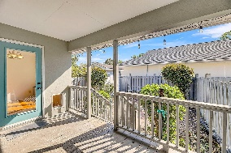
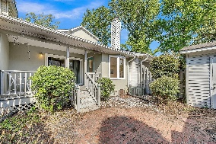
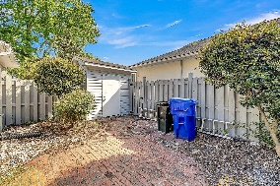
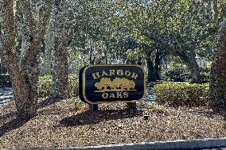
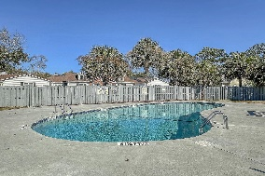
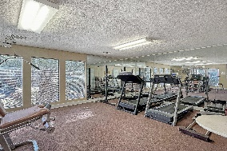


James Island Townhome - New Roof - New HVAC!
982 Harbor Oaks Drive
Harbor Oaks
Charleston, SC 29412
MLS# 24009599
$459,000
3 Bedrooms | 2½ Baths | 1,622 sf
Location, location, location!
This move in ready 3BR, 2.5BA townhome is just a ten minute drive to downtown Charleston, 15 mins to Folly Beach and a mile away from the Charleston Harbor.
NEW ROOF AND NEW HVAC!!
Upon entering the home, you'll see the large dining room off of the kitchen. The kitchen has granite countertops, a pantry, ample cabinetry and an eat in area. There is also access to the back porch and adorable fenced in backyard from the kitchen. The family room has a gas fireplace and sliding door also leading out to the back porch. The primary bedroom is on the first floor as well and has its own bathroom and large closet. Head upstairs to two additional large bedrooms each with great closet storage and a full bath in the hall.
This townhome is located in walking distance to grocery shopping and restaurants. The community clubhouse offers a beautiful pool, sauna and workout room.
Come see this home today!!
Larry & Kathy Mazalatis
Larry Cell 843-693-0529
Kathy Cell 843-693-0159
mazteamrealty@gmail.com
AGENTOWNED REALTY | 1800 TROLLEY RD | SUMMERVILLE, SC 29485

