Slide 1
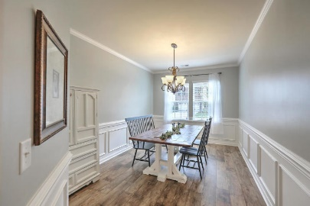
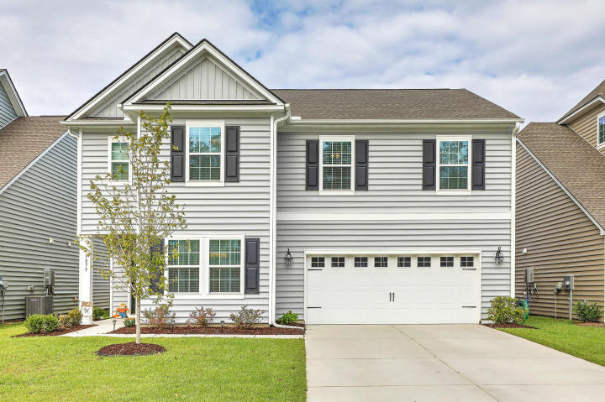
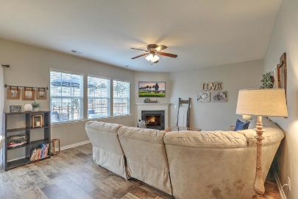
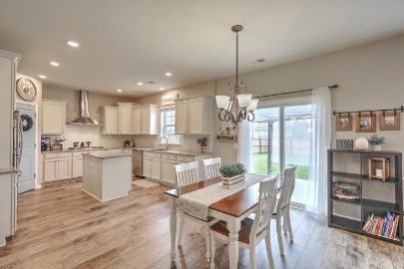
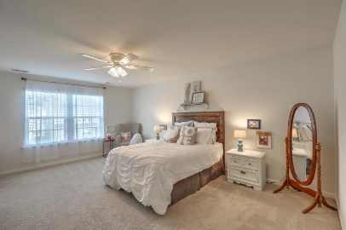
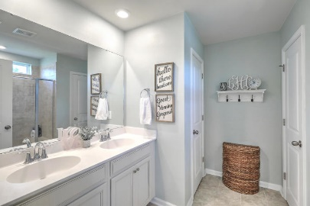
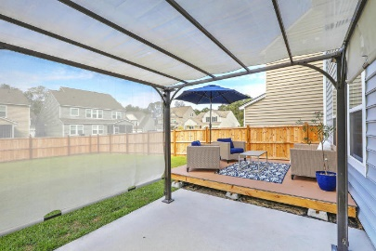
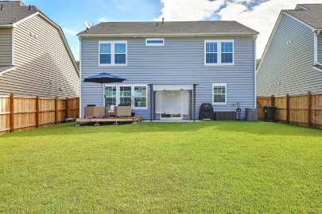


9835 Black Tupelo Lane
Coosaw Preserve | Ladson, SC 29456 | MLS# 18028007 | $294,990
New Price! Seller says Bring All Offers!
Priced below New Construction!!!
First 10 Agents To Show Receive A $25 VISA Card
Why wait to build.
This beautifully decorated Hanover plan less than 2 years old is fully loaded with upgrades to include granite in kitchen, staggered cabinets, subway tile backsplash, stainless appliances w/fridge included. Open concept first floor with separate formal dining room and powder room. Upstairs is a huge loft, master suite plus 3 bedrooms and laundry room. Seller has added a composite deck in backyard, 6' privacy fence, Nest system, gutters, light fixtures and fans and newer paint. Transferable termite bond and builder's warranty transfer to new owner. Newer garage door opener equipment changed out to a quieter model. Pergola on back patio can convey. Award winning DD2 schools, close to Base, Boeing, Bosch, Airport, downtown Charleston, shopping and area beaches.
Beth Mandell
M 843-900-1296 | O 843-871-2121
bmandell@century21properties.com
www.bestcarolinahomedeals.com
Century 21 Properties Plus of Summerville | 118 W Richardson Ave | Summerville, SC 29483

