Slide 1
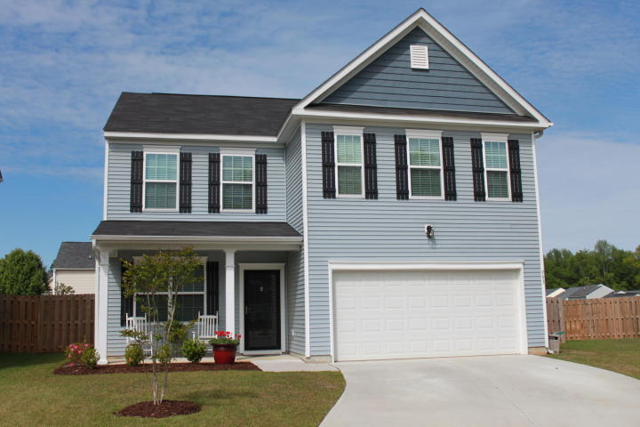
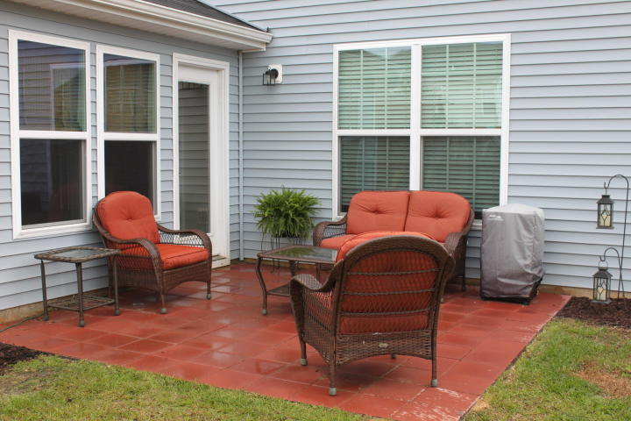
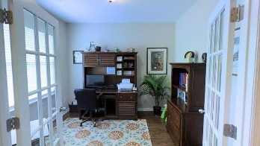
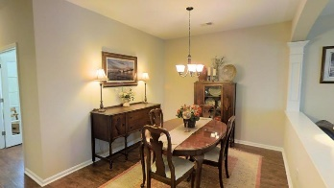
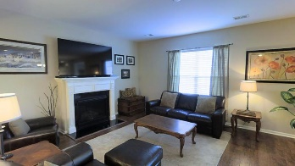
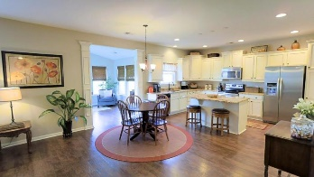
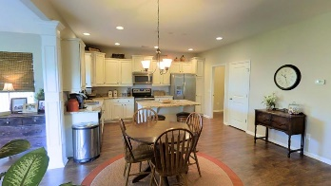
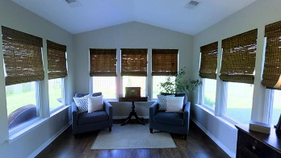
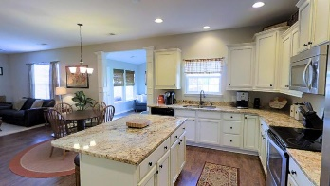
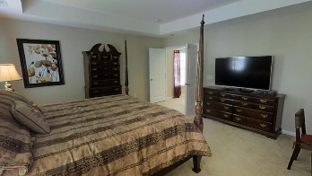
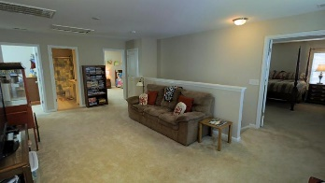
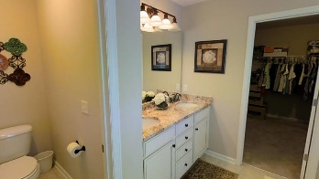
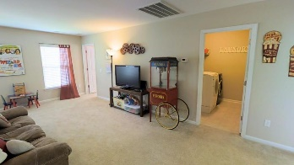
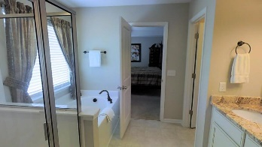
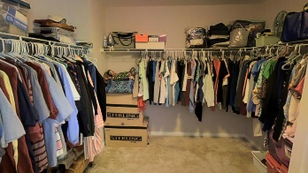
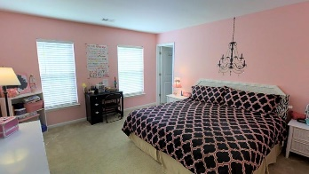
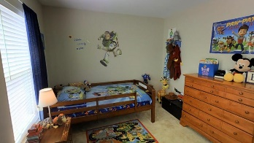
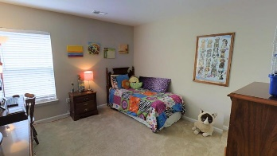



This Better Than New Home Is Ready & Waiting For You
983 Cedarfield Lane
Myers Mill | Summerville
MLS# 16009491 | $279,000
4 Bed | 2½ Baths | 2,800 Sq Ft
Great floor plan with tons of upgrades. No need to wait on new construction, this better than new home is ready & waiting for you. This home is a beautiful two story home with two car garage and sunroom on a cul-de-sac in desirable Myers Mill. See the 3 D virtual tour! When you walk in the front door you see the openness of the floor plan with wood flooring and smooth 9 foot ceiling flowing uninterrupted which allows socializing between the kitchen, family room, sunroom and dining area. This is perfect for entertaining. The office off the foyer with nicely crafted French doors. Fireplace in family room. The kitchen has upgraded cabinets with island and granite countertops beautifully spot lighted by the recessed lighting. Seller will pay up to 5000 closing costs with acceptable offer.
Charles Lent REALTOR, AIC
843-864-6426
charles.lent@agentownedrealty.com
www.charleslentrealty.com
AgentOwned Charleston Group | 902 Savannah Hwy | Charleston, SC 29407-7802

