Slide 1
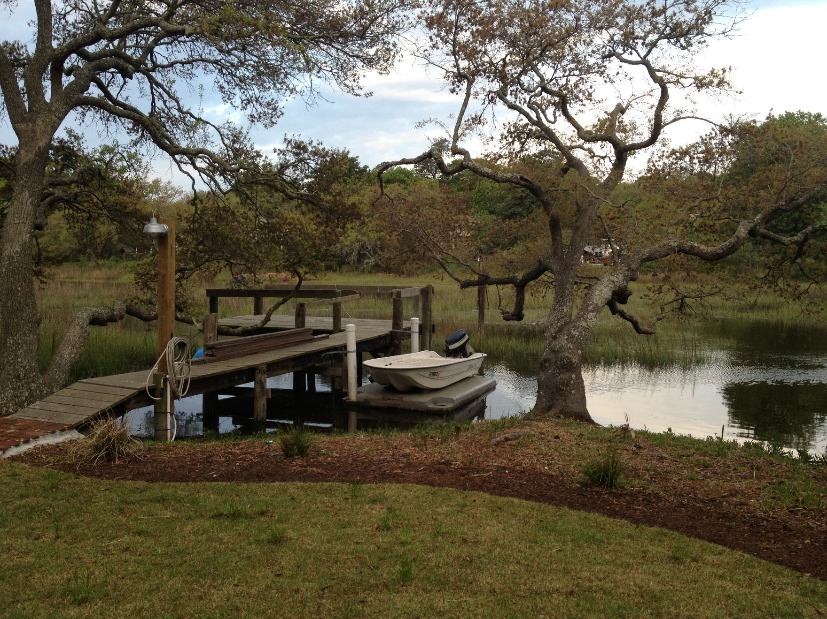
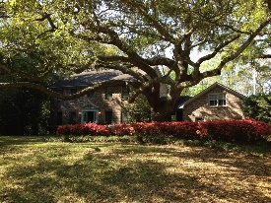
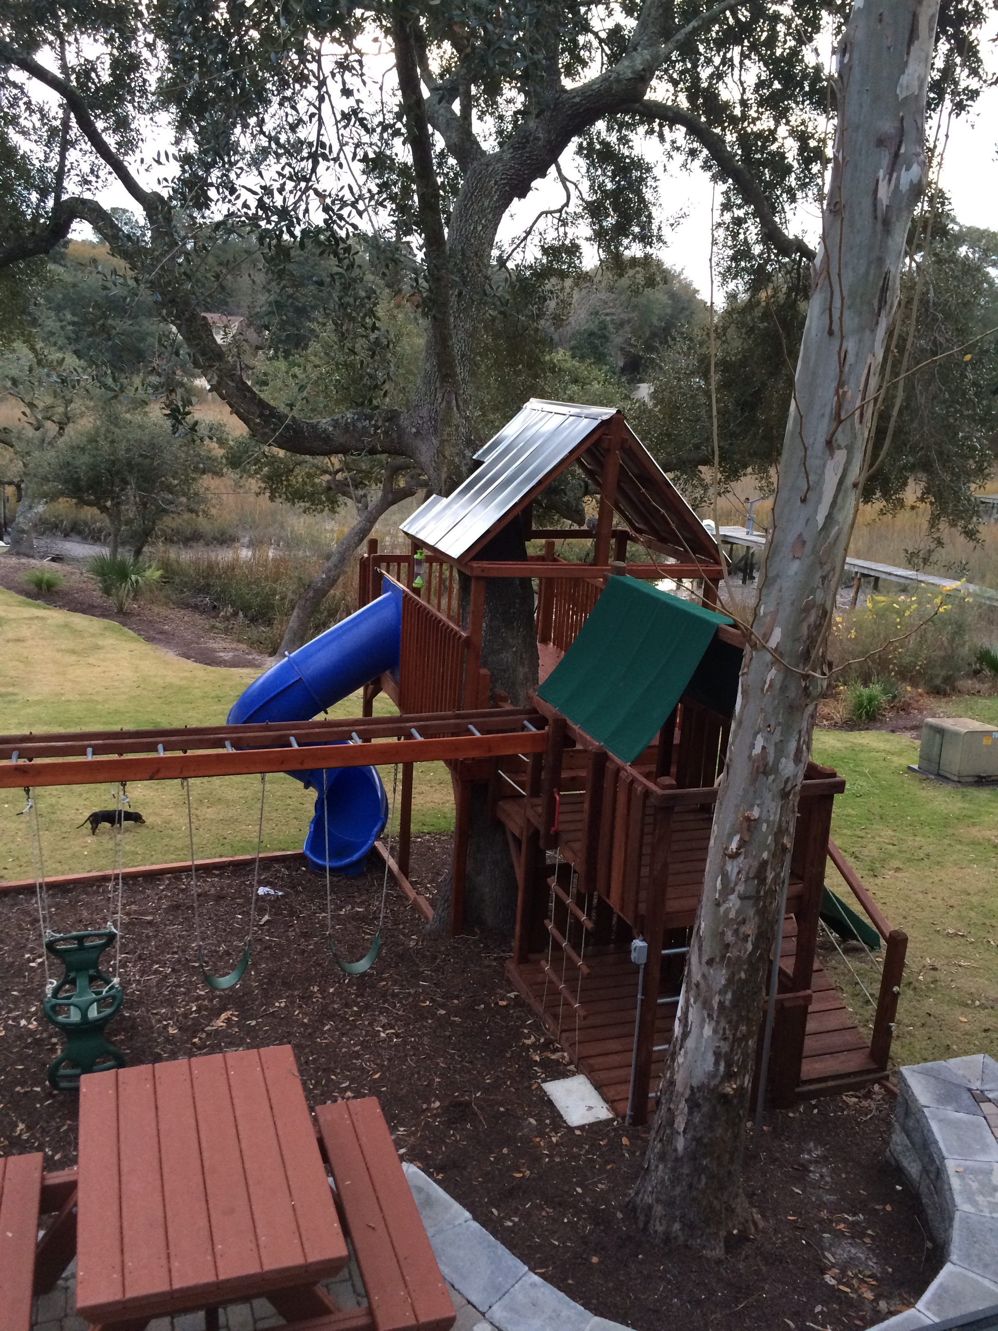

Completely updated home on Beautiful Shem Creek. 4 bed room 3.5 bath or FROG as 5th bedroom. Professionally installed Tree (seven oak trees) and path lighting. Kids tree house with hard wired lighting. Professionally installed zip line. Fire pit with Patio. Lighting, power outlets and fresh water run to dock. Tankless water heater. Dog run. Plantation shutters. Outdoor shower with hot and cols water. Roof only three years old. With current ownership no flood insurance was required.
Water front with Dock
983 Scotland Drive
Creekside Park
Mount Pleasant
MLS# 16004138
$959,000
Kent Jordan
(843) 375-2222
kenteastshore@yahoo.com

