Slide 1
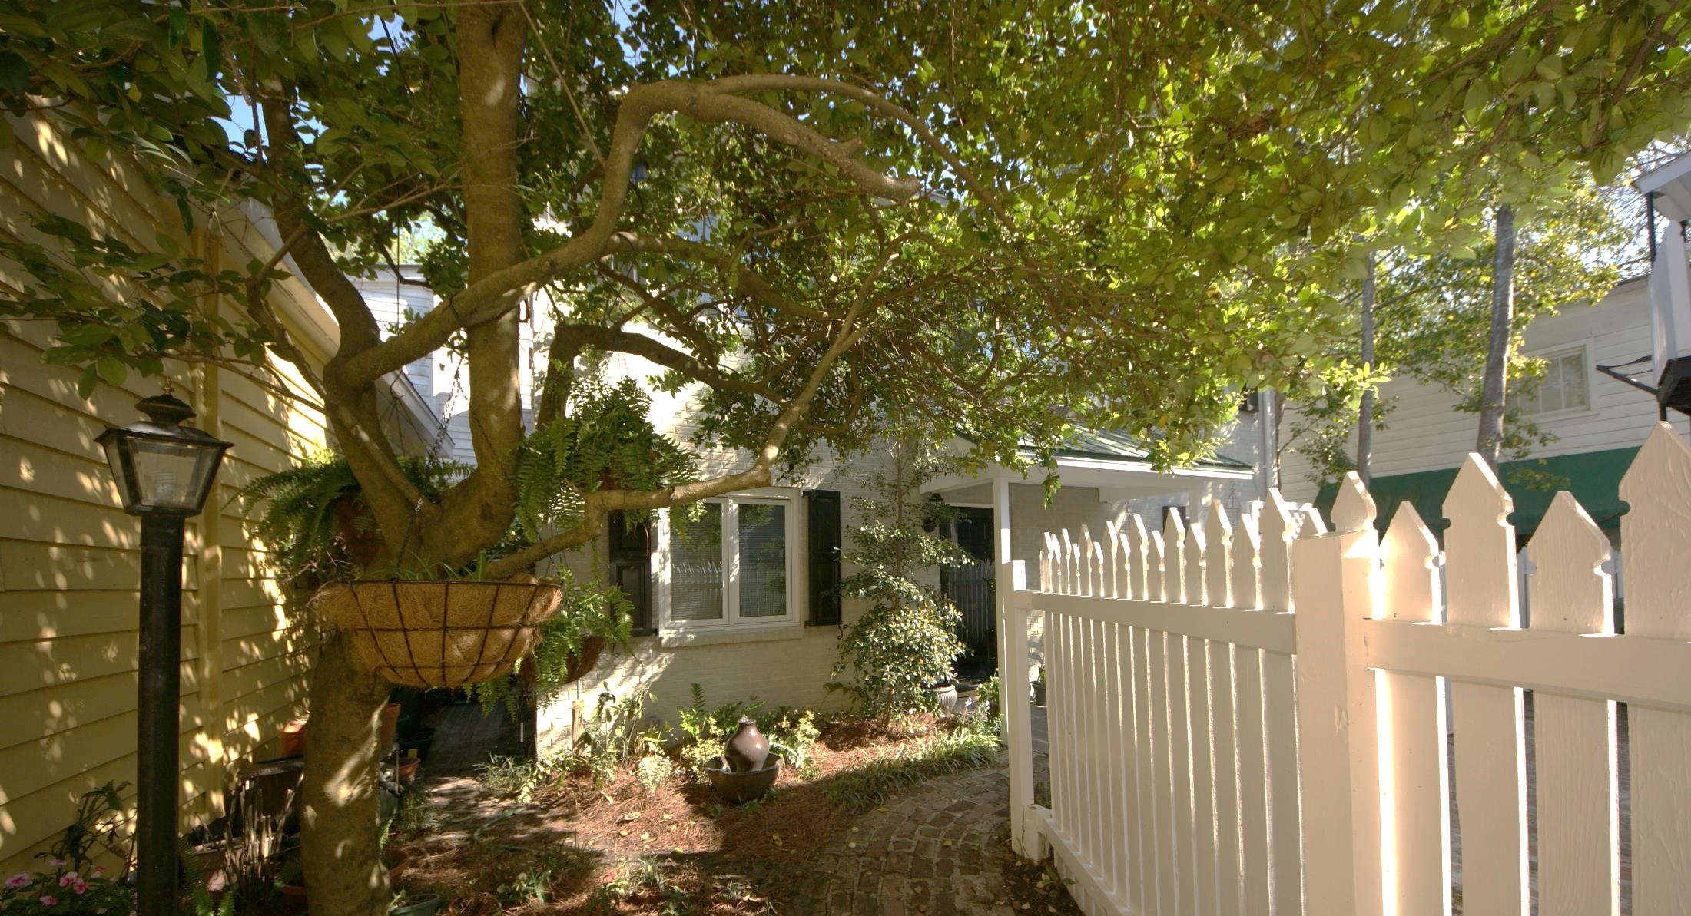
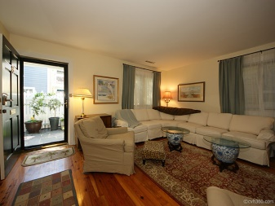
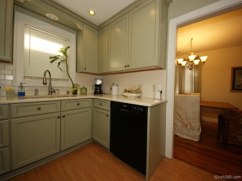
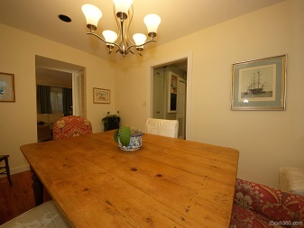
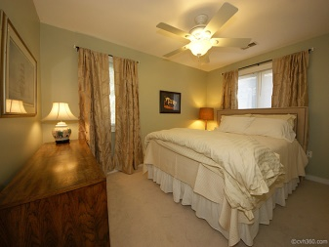
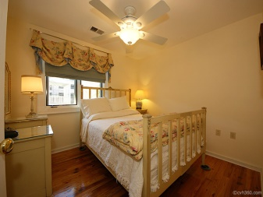
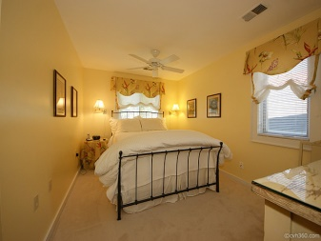

98 Queen Street
Charleston, SC 29401
Less than one block from the intersection of King and Queen streets this charmingly furnished cottage is set back from the street ensuring complete privacy. Open the gate and wander through your very own secret garden to the front courtyard.
The living room, with its gas fireplace, is the perfect place to curl up with a book on a rainy afternoon or gather with friends at the end of an exciting day. The dining room seats six in style and more in a pinch. Charm meets function in the kitchen– you can leave notes for your friends and family on the blackboard while you whip up a wonderful meal in a flash with the microwave that is also a convection oven.
When you need a break choose one of the two Queen size beds or the Full size bed for a wonderful night’s rest. This house can easily accommodate six. With two full bathrooms upstairs and a half downstairs there is no waiting in line!
This home is renting for $5000 per month and the owner will pay all utilities. It will be available the first week in July. Call or email to schedule a walk through.
Graeme Seabrook
843-696-6948
rentals.scv@gmail.com
Charleston Vacation Rental Management
www.vacationrentalscharleston.com
Mount Pleasant, SC 29464

