Slide 1



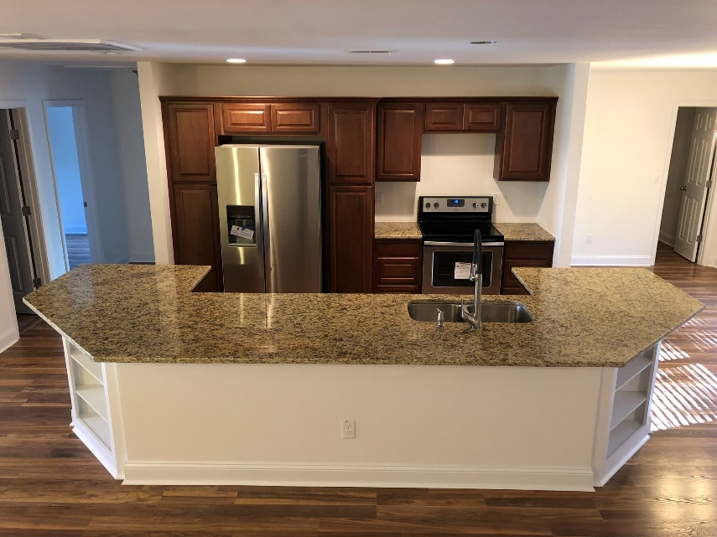

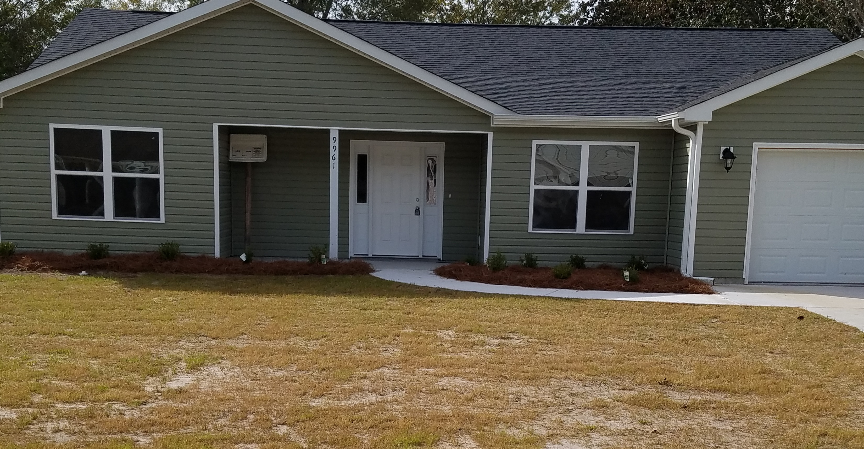
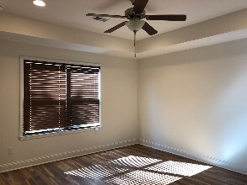
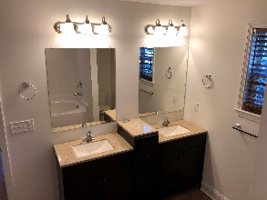


$3,000 Agent Bonus in Time for the Holidays!
9961 Levenshall Drive Heaton Place · Ladson · MLS# 17011662 · $219,000
Brand New Construction of a Beautiful Ranch floor plan that boasts an open and entertaining floor plan that just welcomes you, family, & friends home to spacious living that flows around a centralized granite kitchen bar with a fireplace as the focal point of excellence. Master Bedroom is quietly located in the Northeast corner of the home totally separate from the remaining bedrooms with a contemporary bathroom that features a separate tub and walk-in shower. Smooth ceilings & Upgrades that continue to enhance this floor plan throughout the kitchen with a pantry to complete the ambiance of this home. This home truly has a great execution of space with an Office/Study as you enter the home, Laundry Room, Powder Room, & Patio with an ample backyard for little kids or fur babies to enjoy.
Mattie Nesmith, ABR
Broker-in-Charge
Mobile - (843) 452-3779
mattie@ergroupofsc.com
The Elite Realty Group of SC, LLC
8310-A Rivers Ave
North Charleston, SC 29406

