Slide 1
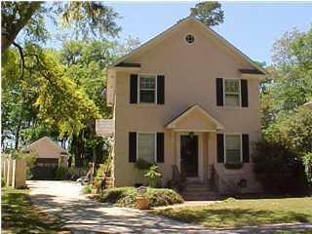
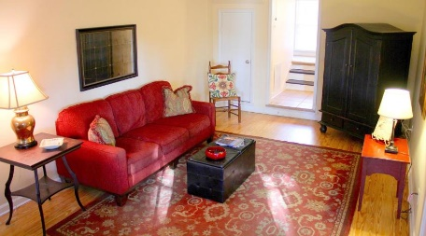
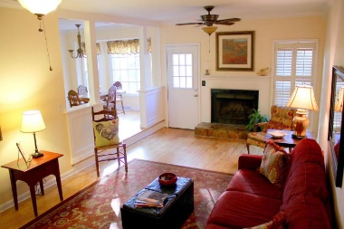
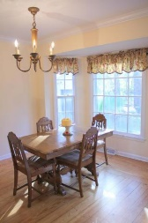
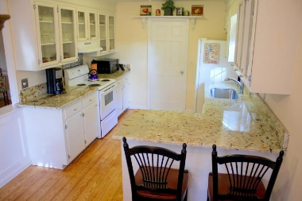
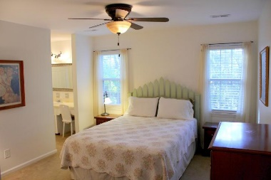
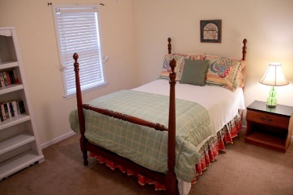
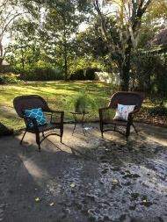
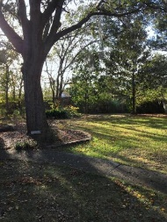
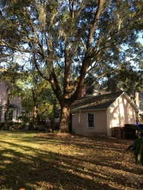
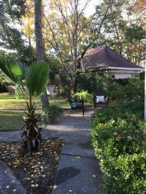
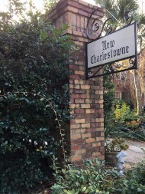

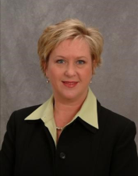

999 Governors Rd
Snee Farm
Mount Pleasant, SC 29464
MLS# 16030320
$389,000
3 Bedrooms ▪ 2 Baths ▪ 1,538 sq. ft.
Open House ~ Sunday ~ 1-4
Just Reduced!!!
New 30 year architectural shingle roof on home! This charming Charleston Single Style home is located in the New Charlestowne section of Snee Farm. The great room features a fireplace and is open to the kitchen which has newly installed granite. The great room and kitchen have beautiful pine floors that were refinished last year. The master suite has dual closets and master bath has tile and a walk-in shower. Two other bedrooms upstairs and another full bath with tile and tub/shower combo. The foyer and half bath have tile and entire home has smooth ceilings. The home is located on an over-sized lot with a huge fenced backyard. Detached one car garage. Snee Farm is centrally located and minutes to shopping, restaurants, beaches and downtown Charleston. Membership is available at Snee Farm Country Club for swimming, tennis and golf.
Jennifer Nipper, Realtor®
(843) 478-1800 | jen@AgentOwned.com
www.AgentOwned.com
The AgentOwned Realty Co | 824 Johnnie Dodds Blvd | Mt. Pleasant, SC 29464
Real Estate • Mortgage • Insurance

