Slide 1
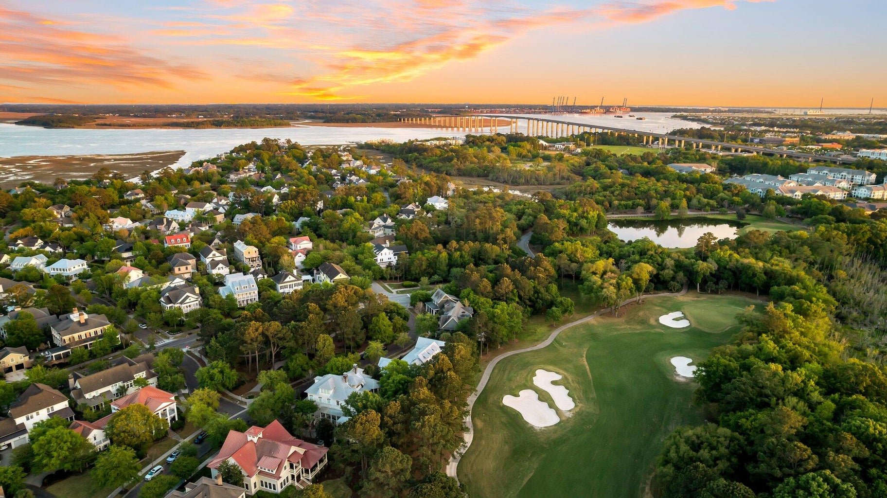

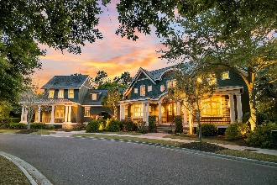
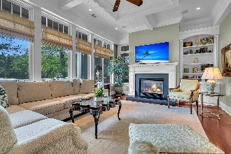
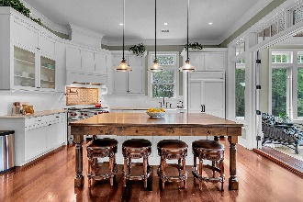
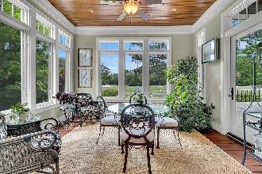
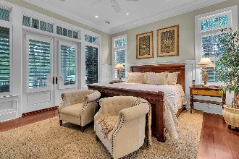
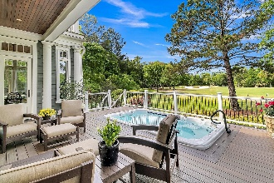
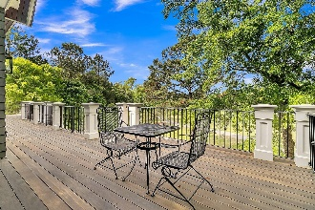
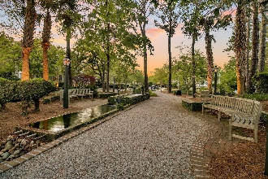
Daniel Island Home
with Full Golf Membership
PRICE
REDUCED
99 Iron Bottom Lane
Daniel Island | Charleston, SC 29492 | MLS# 24009211 | $3,595,000
One of the most iconic homes on Daniel Island, 99 Iron Bottom is being offered for the very first time! This pristinely maintained home overlooks the 3rd hole of the Tom Fazio designed Beresford Creek Golf course and is one of the few homes available with a FULL GOLF MEMBERSHIP attached to the home. Skip the multiple year waitlist and start playing golf on Daniel Island's two private golf courses the moment you close on your new home! Timeless elegance meets picture perfect location in this Daniel Island masterpiece created by Buffington Homes. Buffington Homes is one of Kiawah Island's most prominent home builders, and they only designed and built a few select homes on Daniel Island. With just over 5,700 SF of living space, this 5 bed, 7 bath residence was designed with family and entertainment in mind. The home features cedar shingle siding, a slate roof, double porches on the rear side, a custom swim spa, a spacious first floor primary suite, and a grand kitchen which opens into the great room overlooking the golf course. Home also has an oversized elevator shaft on both floors. Not to be missed on the first floor is the light and bright sunroom that offers the perfect spot to enjoy your morning coffee, or afternoon cocktail while watching the sun set over the golf course. A large media room and a den accompany 3 additional bedrooms on the second floor, each with their own ensuite bathroom. One of the truly special and unique features of this home is the dramatic hallway bridge that connects the main home to a completely private guest suite. This side of the residence also offers an exceptional home office that affords you complete privacy from the main living area. Both the home office on the main floor and the guest suite above it have a separate private entrance to outside of the home - perfect for extended family, college kids living at home or a live-in nanny. Don't miss this unique opportunity to own one of the crown jewels of Daniel Island Park!
Video Tour | Virtual Tour
Paige Rhodes 843-830-3281 paige.rhodes@carolinaoneplus.com

