Slide 1
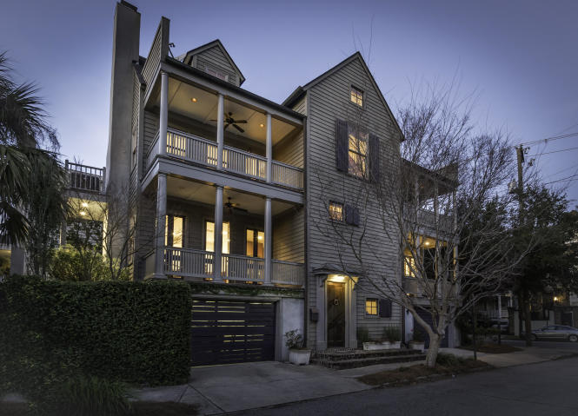
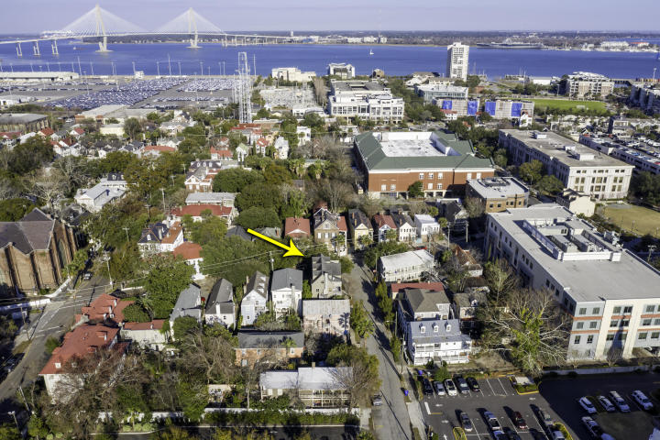
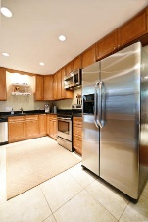
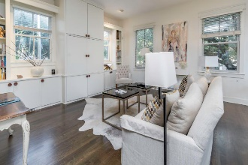
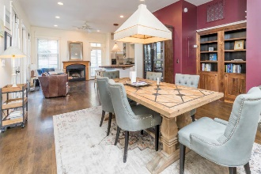
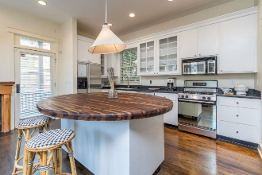
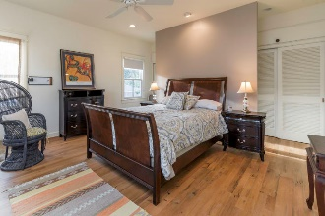
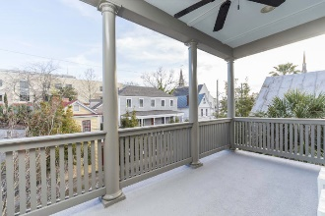
Open House ~ Tuesday, Feb 12th from 11:30-1:30 9 Elizabeth Street Wraggborough ~ Charleston, SC 29403 ~ MLS# 19003650 ~ $1,355,000
Designed by renowned architect, Reggie Gibson, this circa 1999 elevated property on a corner lot combines an impeccable blend of modern amenities with traditional Charleston charm! Upon entering the foyer on the ground level, a rosewood and oak spiral staircase is uniquely positioned at the front of the home. The open floor plan on main level is perfect for entertaining, and also features balconies that extend from the kitchen and living room allowing for an abundance of natural light. Oak and reclaimed wood floors combine with the attractive and functional built-ins to enhance this entire living space. As you walk upstairs to the spacious dual master suites, you will find a library workspace at the landing in between the two bedrooms. The top floor boasts a third bedroom, full bathroom with a soaking tub, and additional flex space suitable for a fourth bedroom, playroom, study, or craft room. Finally, enjoy the convenience of a two-car garage and expansive laundry room and private brick courtyard. This central location, just blocks from restaurants, galleries and Marion Square allows you to enjoy all that downtown has to offer!
Trey Morrison
trey@landsouthofcharleston.com
Mobile 843-697-6849
Land South of Charleston, LLC | 180 E Bay St Ste 300 | Charleston, SC 29401

