Slide 1
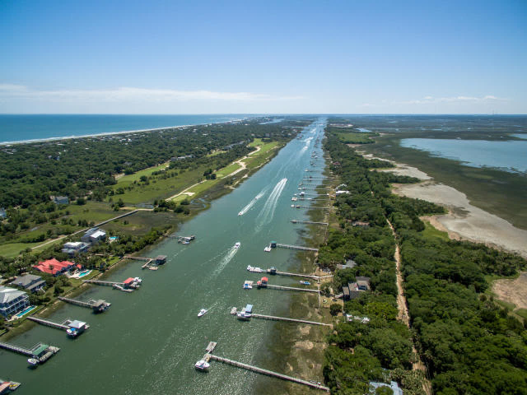
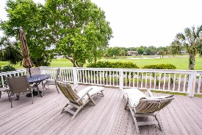
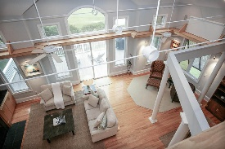
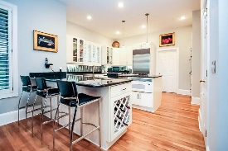
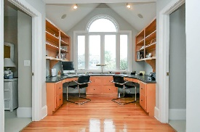
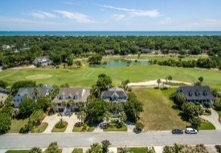
9 Intracoastal Court
Wild Dunes · Isle of Palms, SC 29451 · MLS# 16015153 · $899,000
This "artist inspired" Island home, with beautiful views of the Wild Dunes Harbor Golf Course, situated on a quiet cul-de-sac street across from the Intracoastal Waterway, is one you will not want to miss. From the moment you enter this "one of a kind" home, you immediately are drawn to its wonderfully unique entryway and exquisite views. With it's large 2-story Great Room open to the dining area and kitchen, along with doors leading out to the large open deck, this home provides the perfect setting for entertaining guests or spending time with family. The well-designed kitchen boasts granite countertops along with beautifully tiled back-splash, stainless steel. Along with a powder room and laundry, rounding out the first floor is the Master Bedroom with multiple walk in closets, a large Master bathroom with soaking tub, dual vanities, and walk in shower. Walk upstairs and you are greeted with views of the Intracoastal. A relaxing area for your office as well. 2 spacious bedrooms with 2 perfectly remodeled bathrooms. These bathrooms come with tile floors, granite counters, and wonderful tiled showers with frame-less glass doors. The underneath of the home has tons of storage along with 2 parking areas. There is also a room that is temperature controlled, currently used for an art studio. Light nights and sprinkler system. keep the grounds looking great, The location of the home puts you walking distance from the Marina and Morgan Creek Grill. Easy golf cart ride to the beach, Harris Teeter, and all the other things the island has to offer. This is the perfect island home.
Let your island dreams come true…
Neil Schneider · 843-200-8902 · neil@charleston.info

