Slide 1
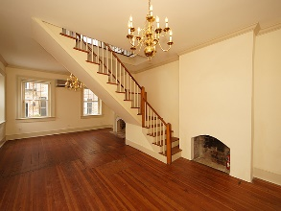
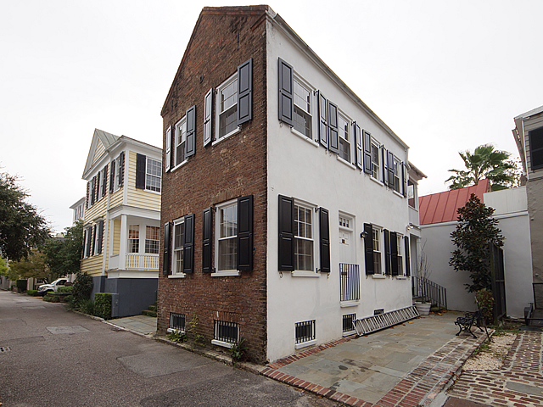
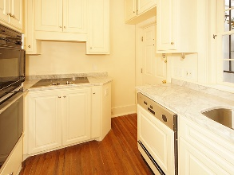
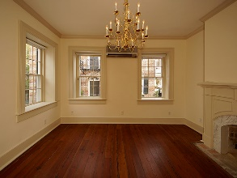
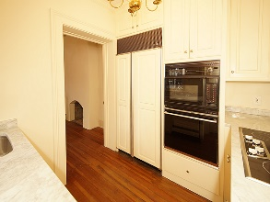
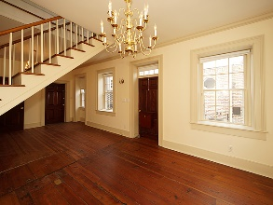
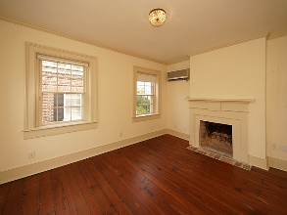
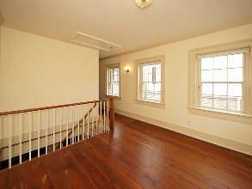
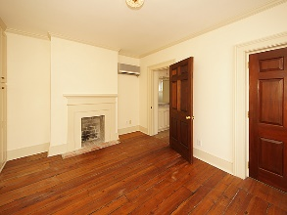
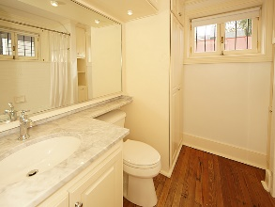
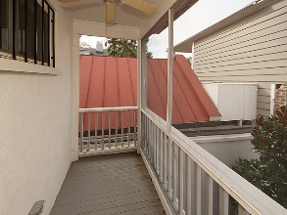
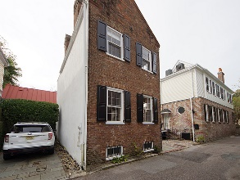

9 Lamboll Street South of Broad | Charleston, SC 29401 MLS# 18001563 | $699,000
South of Broad for Under $700,000
CHARMING HISTORIC HOME IN PERFECT SOUTH OF BROAD LOCATION ON LITTLE LAMBOLL. MOVE IN CONDITION WITH OFF STREET PARKING. BEAUTIFUL LIGHT AND OPEN FLOOR PLAN SET THIS 1810 HOME APART. IT IS A PERFECT PIED A TERRE WITH ONE BEDROOM, A SITTING ROOM, BATH AND SCREENED PORCH UPSTAIRS; LIVING ROOM, DINING ROOM AND KITCHEN DOWNSTAIRS.
LOW MAINTENANCE BRICK AND STUCCO EXTERIOR WITH ALL NEW WORKING SHUTTERS. NEW GRANITE COUNTERTOPS IN KITCHEN AND BATH. THERE ARE THREE OLDER MINI-SPLIT HVAC UNITS. ONE BLOCK FROM THE BATTERY AND WALKING DISTANCE TO DOWNTOWN SHOPS, RESTAURANTS AND ENTERTAINMENT.
$550,000
HEIDI RAVENEL REALTOR (843) 670-1166 | hravenel@arjrc.com www.ravenelrealestate.com/
Arthur Ravenel Jr. Co.
105 Wappoo Creek Suite 4A
Charleston, SC 29412

