Slide 1

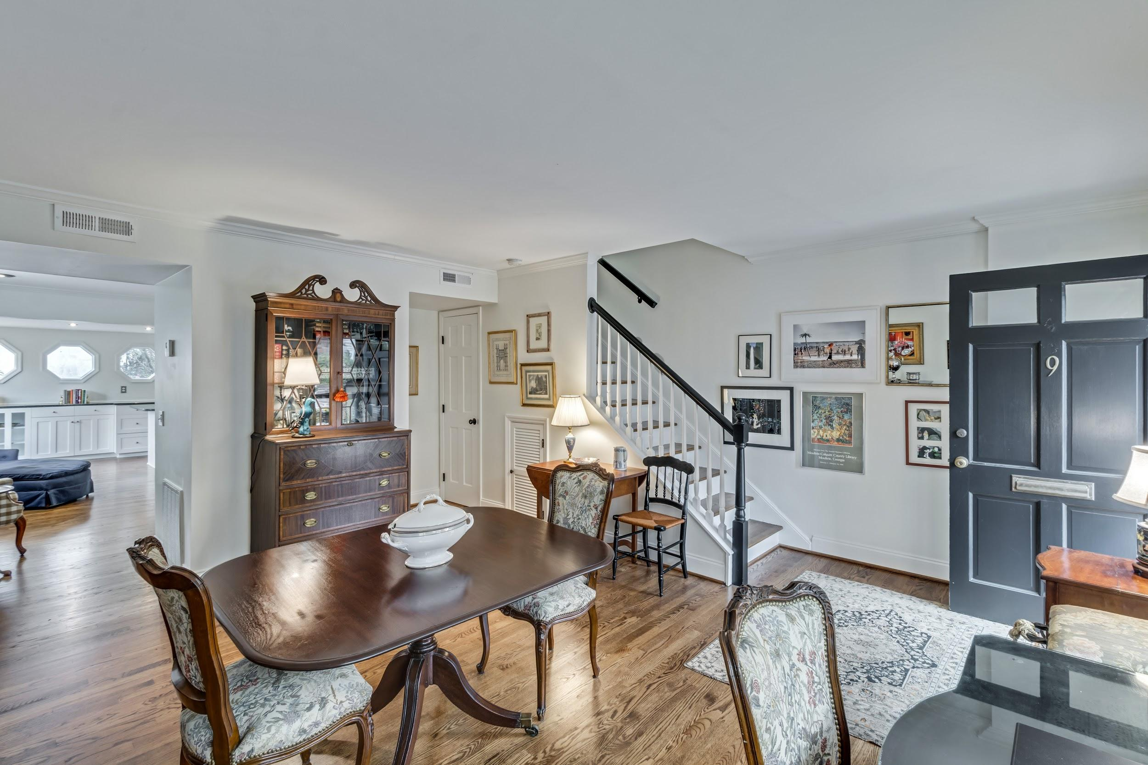
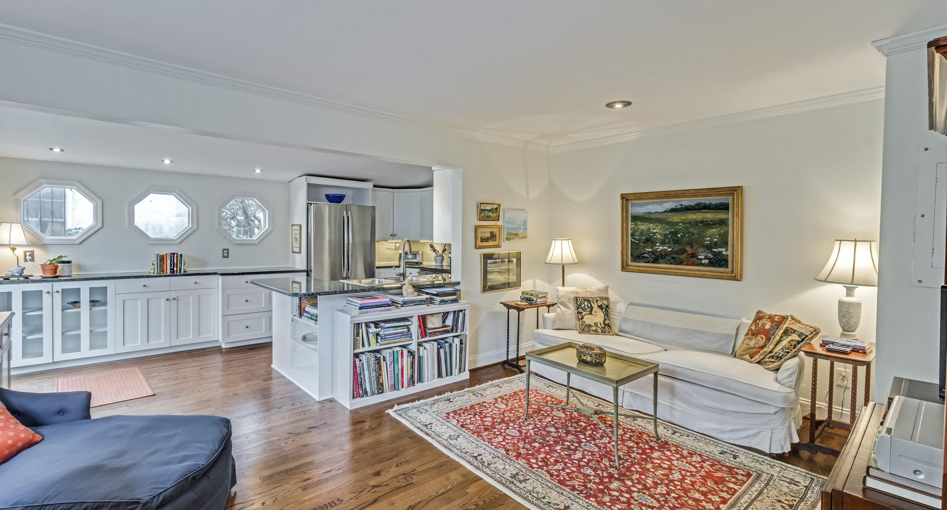
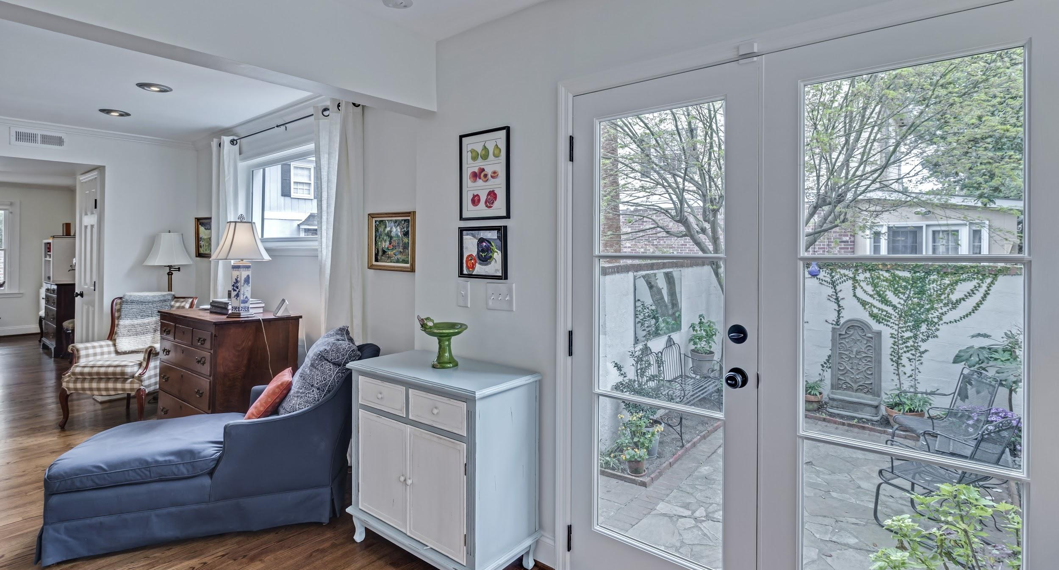

Charming
9 Poulnot Lane, Harleston Village
$645,000 - 2 Bed - 2.5 Bath - 1 Deeded Parking Space - 1,348 sq. ft.
Kay Kennerty MBA
843-345-5011
kay@agentownedrealty.com
kkennerty@aol.com
Notes:
To get started: From the Menu, select File, then Make a Copy, then Rename the copy to the Property Address.
To maintain the structure of this template, please follow these Guidelines.
Do not change the size of any image holding box, or the color of any image boxes.
Do not change the font styles, or the color of the fonts, or the size of the text holding box.
To change images: Right-Click on the image, then Replace Image, then Upload from Computer.
To adjust the new image: Click once, then select the Crop tool, you will see a black border line and a blue border line. Use the blue border line toggle points to adjust the placement. (do not adjust the black holding box)
To edit text: Click on any text, and type. If you run out of room, highlight all the text and adjust the font size from the menu. (do not adjust the blue holding box)
Note: Some elements are not editable, such as logos or company information.

