Slide 1
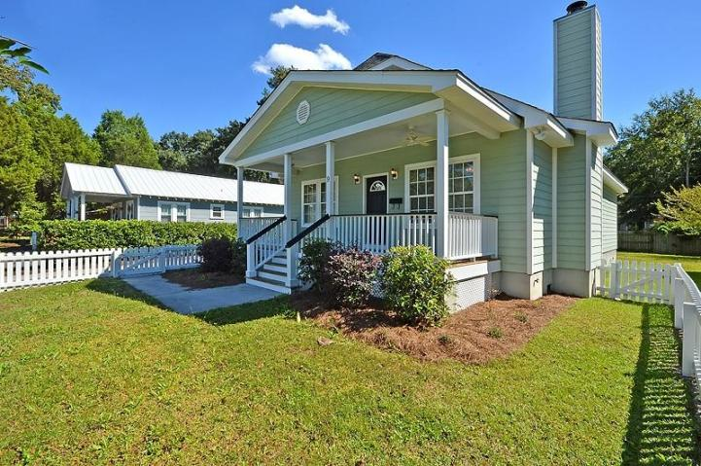
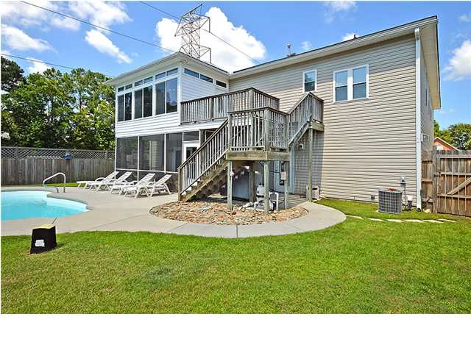
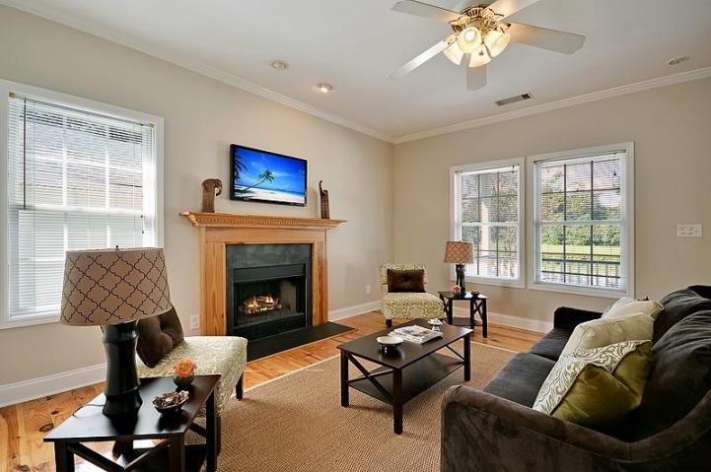
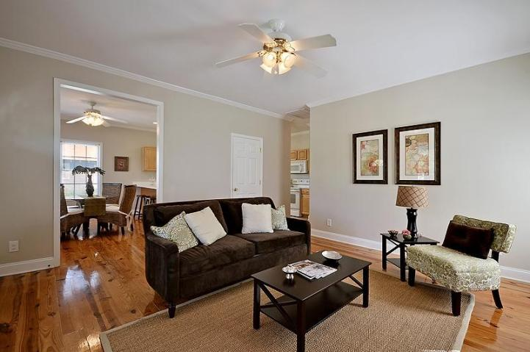
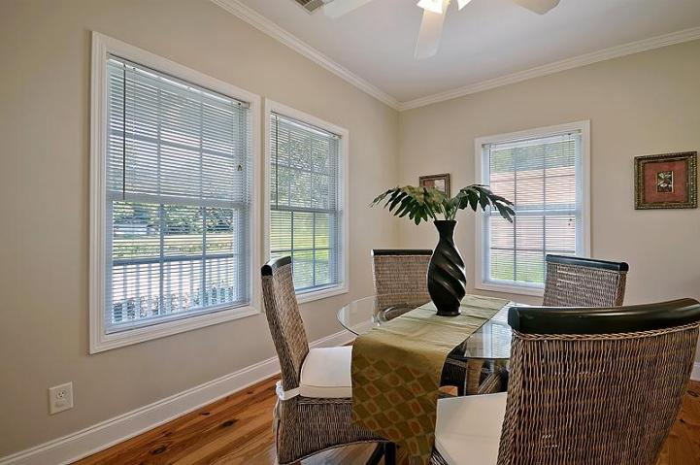
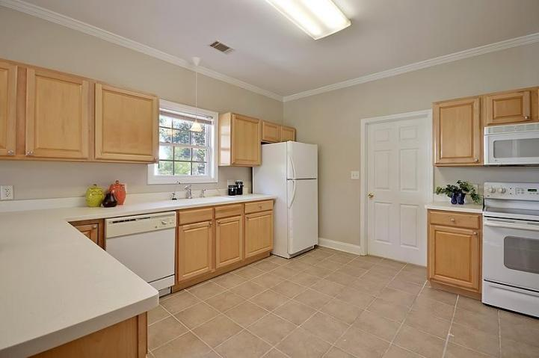
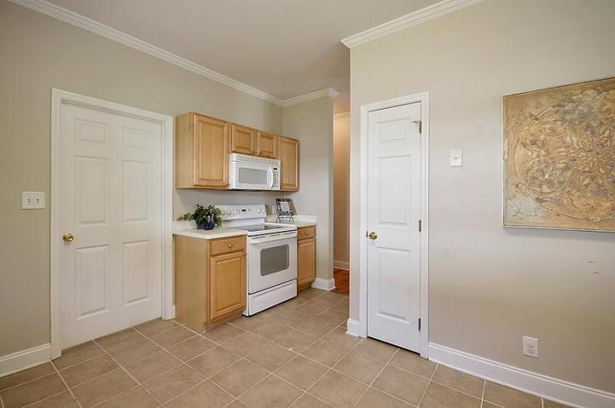
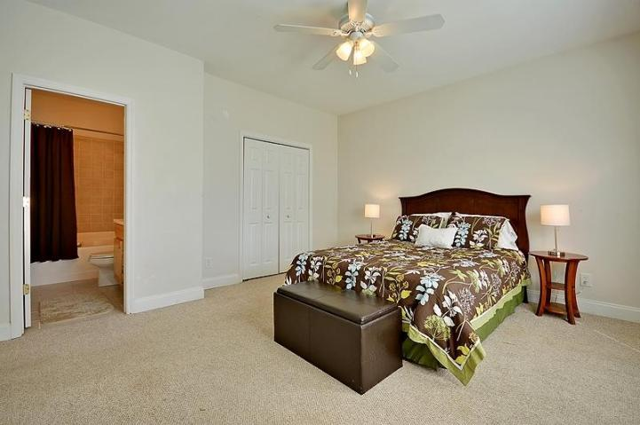
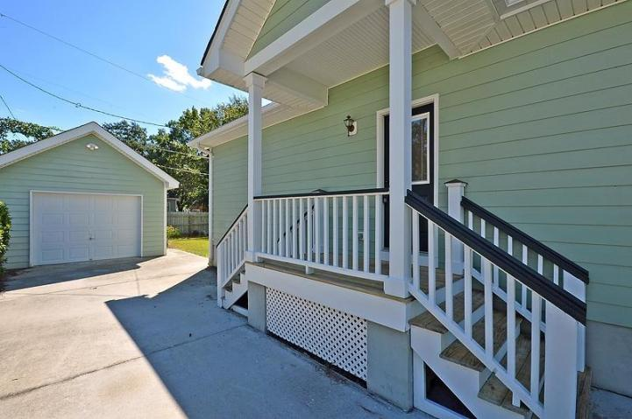
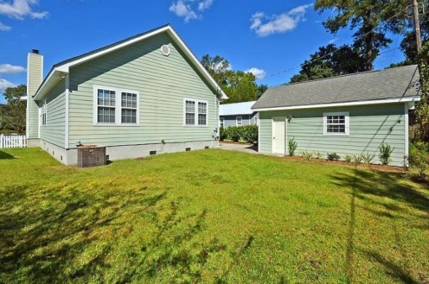

Price Reduced!
$40,000 Price Reduction in Avondale
9 Sycamore Ave ~ Charleston ~ MLS# 1424525 ~ $259,000
AVONDALE CHARMER!!! Welcome to the highly desirable Avondale section of West Ashley. You will feel right at home the minute you step into this beautifully finished bungalow. The meticulously maintained landscape and charming white picket fence welcome you to the covered front porch...the perfect spot to enjoy your morning coffee. Inside, the open floor plan features gorgeous pine hardwood floors and a spacious living room with a wood burning fireplace. The kitchen offers everything you'll need including a glasstop range, tiled flooring, lots of cabinet space, and a breakfast bar. Just off the kitchen is the separate dining area. The roomy master bedroom is the perfect spot to relax, and you'll love the walk-in closet and garden tub in the master bath. Pass through the laundry room to the lovely backyard where you will find the detached garage. The icing on the cake is the location! This location can't be beat...you are minutes from historic Downtown Charleston, beautiful Folly Beach, and lots of great shops and restaurants. Close by, you will also find the West Ashley Greenway and the shops of Avondale within walking distance. This beautiful home definitely won't be around long, so book your showing today!
Call/email for details: Hamilton Horne (843)708-0584 Hamilton@MattOneillTeam.com

