Slide 1
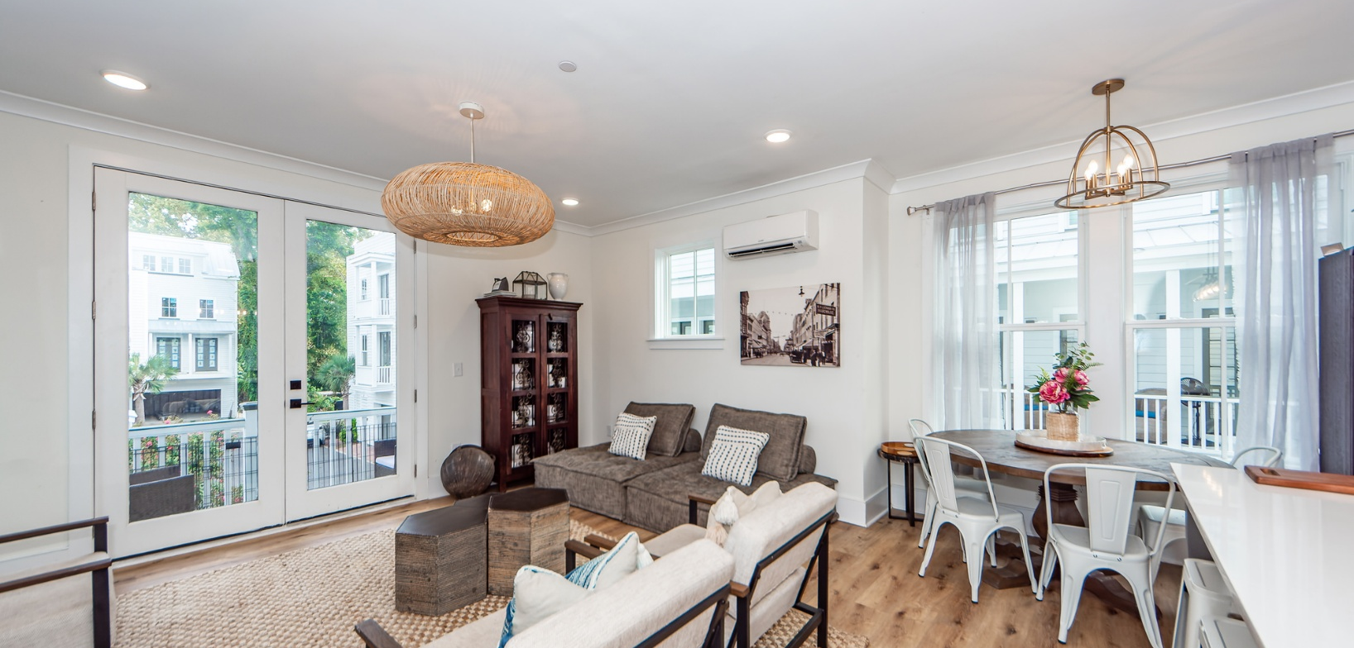

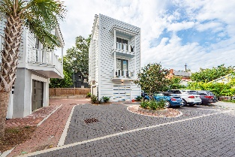
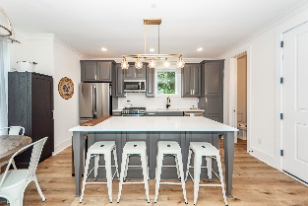
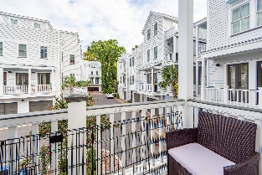

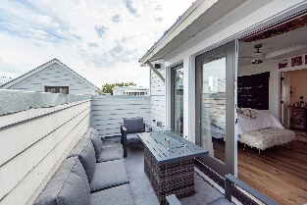


9 Iron Forge Alley
Charleston, SC 29403 | MLS# 24026914 | $910,000
Live And Work Here
VIRTUAL TOUR
Hidden Gem in downtown Charleston, this neat, well maintained community exhibits all of the nuances of Charleston and is wrought with history as this was the Iron Forge district of Charleston in the 1700s. There are 14 beautifully designed homes. A spacious two car garage is one of the many great perks as well as the beautiful window fixtures that provide so much natural light, and lovely views. This home is a must-see if you are looking for a home in the heart of America's friendliest city. Medical University of South Carolina, The College of Charleston, and The Charleston School of Law are just minutes away from this location.
John Vance
843-814-0039
jcvance29483@gmail.com
Charleston Realty Pros, LLC | PO Box 2653 | Summerville, SC 29484

