Slide 1
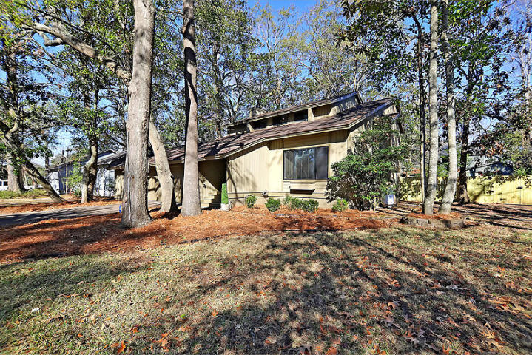
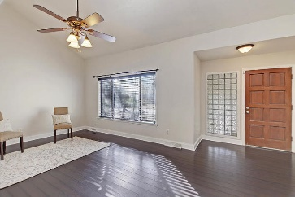
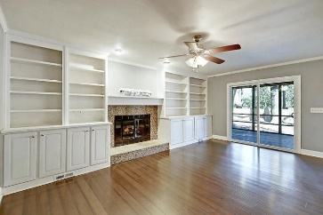
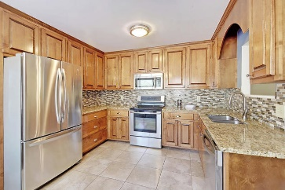
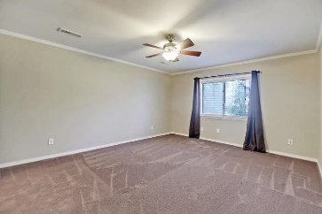
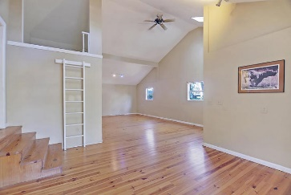
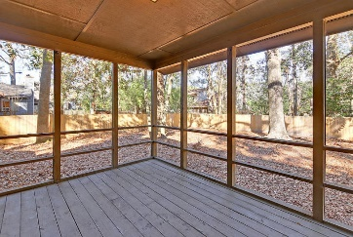
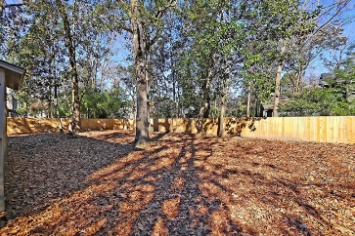
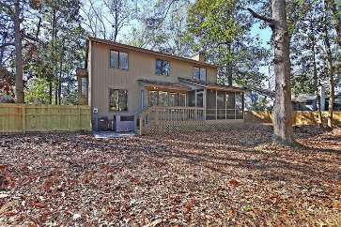

9 Pony Lane
Charleston, SC 29407 · MLS# 20013597 · $350,000
Ashborough on Lake w/Dock only $375,000
Deal of the Day!
Seller will pay buyer's agent $5,000 at closing
with accepted offer by noon June 7, 2019!
Desirable Marsh Cove! $5,000 credit for paint/landscaping! This is an easy commute to Boeing, Historic Downtown Charleston, MUSC, College of Charleston, St Francis Hospital plus so much more. Downstairs features bamboo hardwood and tile flooring, crown moldings and vaulted ceilings; formal living and dining rooms; a family room with fireplace and built-in book shelves; eat-in kitchen newer cabinets, granite counters and backsplash. Home has laundry/utility room plus an amazing 468 sqft bonus room addition that has enough space for a home office/4th bedroom or artists studio. Upstairs features large master suite with walk-in closet, dual sinks and custom tiled shower. When you're ready for some relaxation. Two good size guest bedrooms and a guest bath. You won't be disappointed by the large screened porch with attached deck which is perfect for grilling and entertaining family and friends. There is a pool and tennis court within the neighborhood plus you are only 20 minutes to area beaches.
Stan Huff
843-670-2835
stan.huff@agentowned.com
Jill Marcacci
843-297-5590
jill@agentowned.com
www.agentownedrealty.com
AgentOwned Realty Co. Preferred Group, Inc. | 824 Johnnie Dodds Blvd | Mt Pleasant, SC 29464

