Slide 1
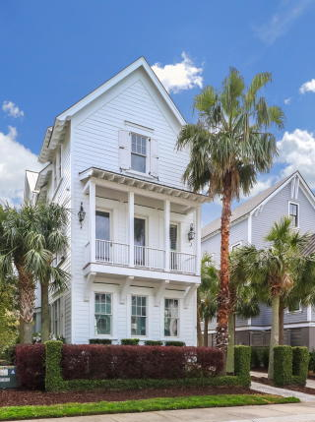
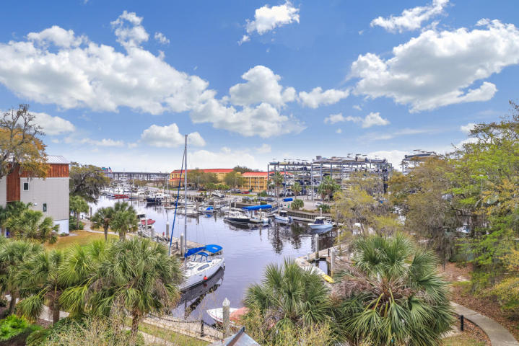
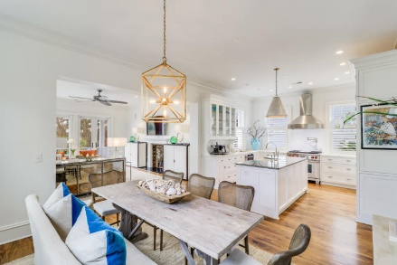
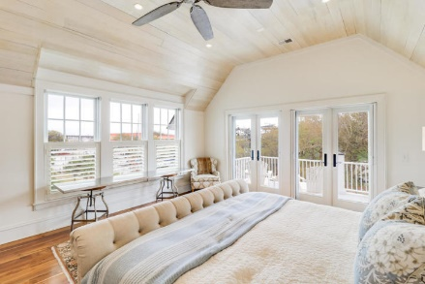
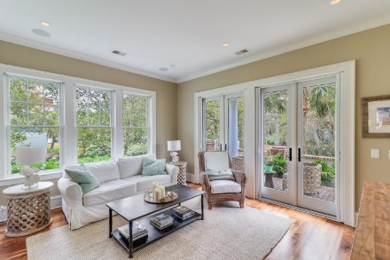
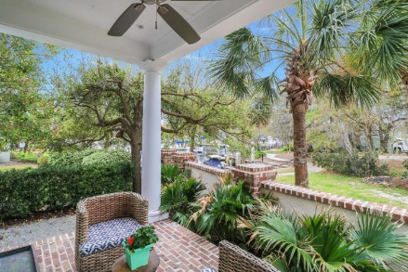
9 Transom Court Ripley Cove | Charleston, SC 29407 | MLS# 20007991 | $1,640,000
Price Reduction on High & Dry
Deep Water Home With 60-Ft Slip In Your Backyard
5 Minutes to Downtown
Charleston
PRICE REDUCTION ON HIGH & DRY DEEPWATER HOME
PRICE REDUCTION ON HIGH & DRY DEEPWATER HOME
Downtown Charleston is accessible in just a few minutes as is Porter Gaud School. Designed by renowned architect Darryl Cobb and custom built by Sintra Homes in 2007. This stately residence is ideal for capturing spectacular harbor views. 1st floor includes entry foyer, two en suite bedrooms w baths, study and a media room that opens up to a covered porch overlooking Ripley Cove. 2nd floor open floor plan includes gourmet kitchen w custom cabinetry, natural stone surfaces, Wolf range, Sub Zero refrigerator and Bosch dishwasher. The custom cabinetry is integrated with appliances. Living room is complete with handsome fireplace and leads to a covered porch with harbor and downtown skyline views. There is a study on the second floor that is adjacent to the powder room. 3rd floor is home to a master bedroom suite which includes a dramatic vaulted and white-washed paneled ceiling, custom closet system, porch overlooking the water and spa-like bathroom with beautiful tiles and European limestone finishes. Additionally, on this floor is the fourth en suite bedroom and a laundry room. Significant architectural features include tall soaring ceilings, gleaming walnut hardwood floors, gorgeous cabinetry and trim package, brilliant floor plan and an elevator to all three floors. Truly this home is a lifestyle designed for easy, Lowcountry living.
Exit Realty of the Carolinas
1165 Chuck Dawley Blvd
Mt. Pleasant, SC 29466
Keith Moore 704-996-0905
keith@charlestonrealtor.pro

