Slide 1
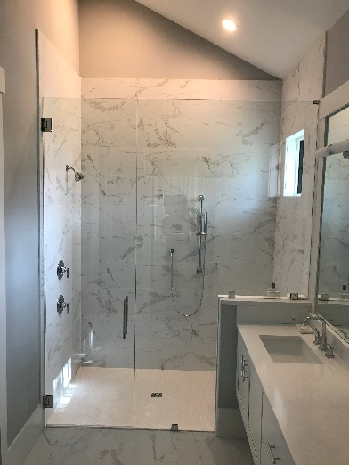
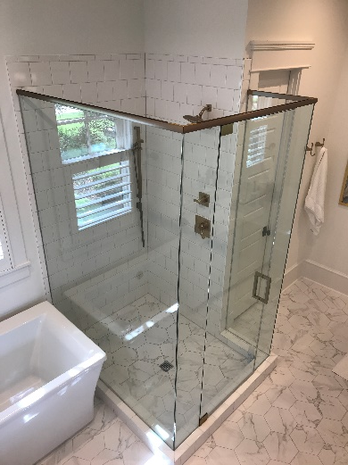
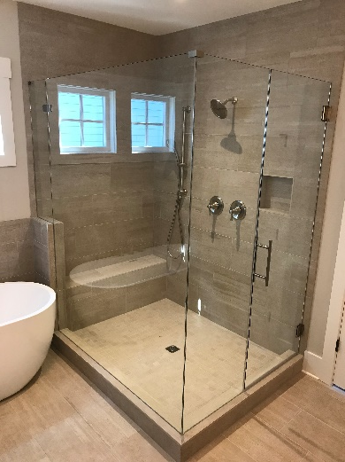
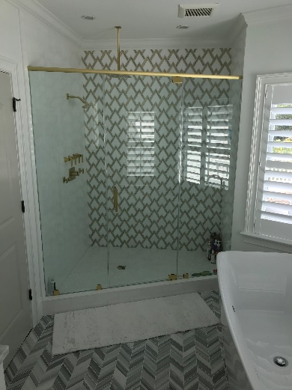
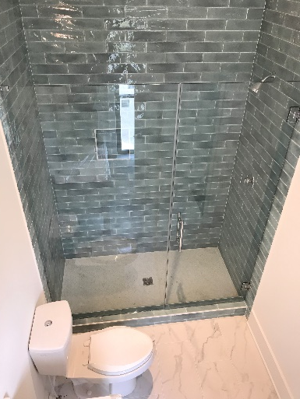

A1-GLASS
SHOWER DOORS
FOGGY WINDOWS
IN GLASS DOGGY DOOR
A-1 Glass is a company servicing installation of custom shower doors, insulated glass windows, custom mirror and shelving. We dedicate our services to all counties in the South Carolina area.
Our mission is to become the most desirable company to work within to strengthen our relationships with our valued customers. Building a reputation for reliability, quality, service, and convenience. We honor our commitments. We are consistent and fair. We genuinely care and sincerely appreciate your patronage.
Certified Glass Technician Since 1999
* Custom Shower Units * Windows * Glass Replacements * Mirrors * Tabletops * Wire Shelving
Call us today! 843-225-4564
A1-GLASS
a1glasscharleston.com

