Slide 1

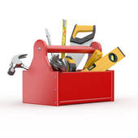
A Better Morrow LLC
Offering:
Painting
Sheetrock Repair
Trim Wood Replacement For CL-100
Handyman Repairs
10% discount for military or Senior Citizens
Veteran-owned business
abettermorrowllc@gmail.com
843-356-2346
Find us on Facebook https://www.facebook.com/A-Better-Morrow-LLC-302160983448266/

