Slide 1
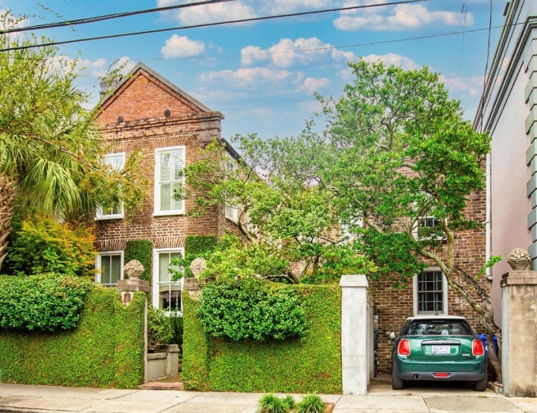


Unique Downtown Property In Ansonborough
If you have anyone interested in a home with:
3 bedrooms…
3½ baths…
a private walled garden…
an off-street parking spot…
and just under 2,000 SqFt…
Please let me know. Asking will be $1.6m.
Thank you, Brian
More pictures available
upon request…
Brian Walsh
(843) 754-2089 | Brian@williammeans.com
www.charlestonrealestate.com
William Means Real Estate, LLC | 41 Broad St. | Charleston, SC 29401-2901

