Slide 1

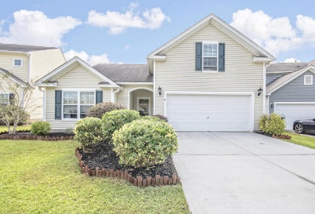

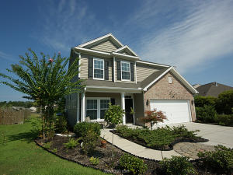
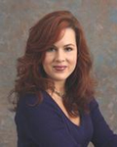
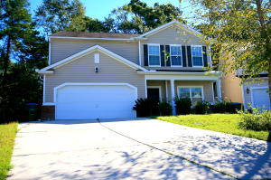

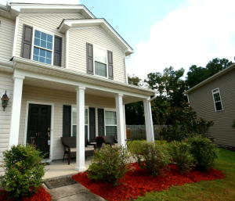
Progressive Open House
Wednesday, Nov 4th, from 11:30-1:00
Arbor Walk Community
Lunch / Dessert / Prizes
214 Goldfinch Lane
MLS# 15026283
$199,000
4 Bed | 2 Bath
1,881 sf
Beth Mandell
843-900-1296
bmandell@century21properties.com
Have A Bite To Eat
$100 To Realtor Who Guesses Closest To Selling Price. Paid After Closing.
472 Dolphin Drive
MLS# 15021863
$235,000
3 Bed | 2½ Bath
2,377 sf
Danielle Fink
843-345-5141
dfinkrealty@gmail.com
Enjoy A Tasty Dessert
116 Purple Martin Trail
MLS# 15025305
$208,000
4 Bed | 2½ Bath
2,411 sf
Tabitha Trite
843-480-5310
info@howtosellmyhousecharleston.com
Leave Your Business Card To Be Entered In A Gift Card Drawing
115 Purple Martin Trail
MLS# 15026497
$250,000
4 Bed | 2½ Bath
2,705 sf
Tabitha Trite
843-480-5310
info@howtosellmyhousecharleston.com
Leave Your Business Card To Be Entered In A Gift Card Drawing
Directions: Bacons Bridge, right on Dolphin, right on Goldfinch.

