Slide 1
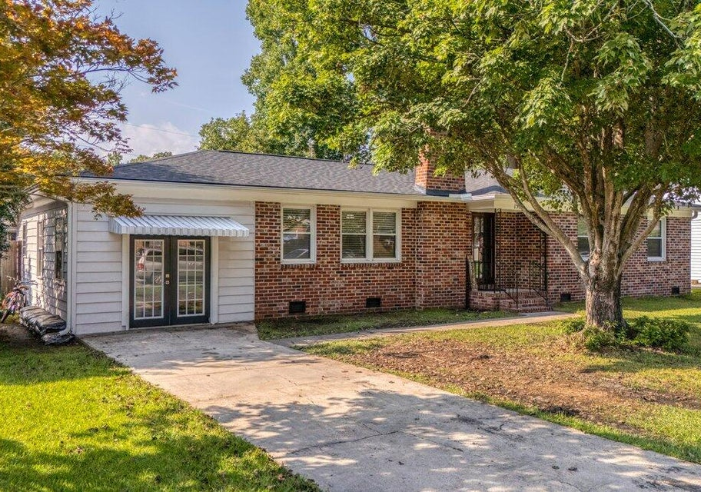

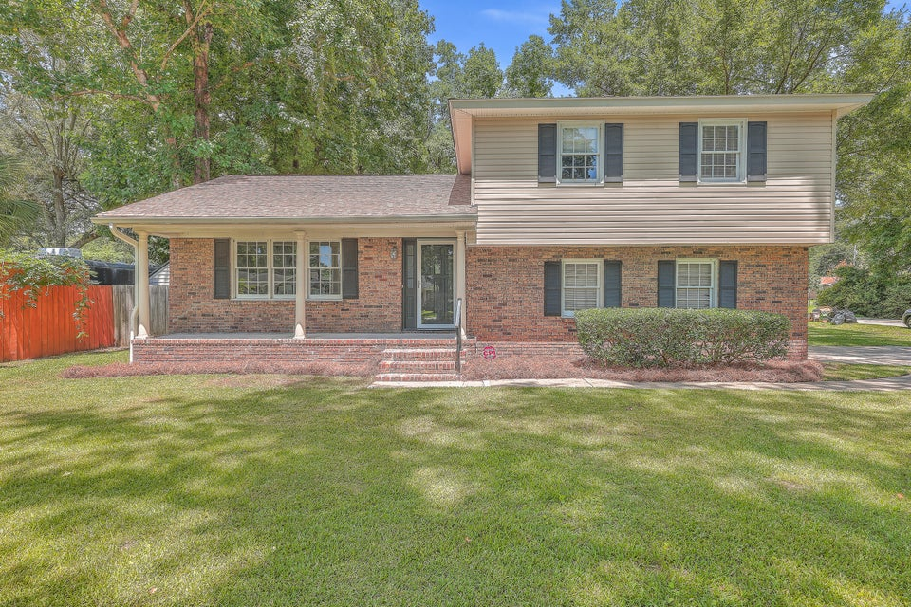

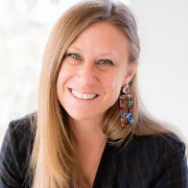
DUAL OPEN HOUSE in Ashley Hall Manor
Saturday 9/14 12-3PM
1516 Birthright Street
Charleston, SC 29407
MLS# 24021193
$665,000
Elissa Campbell
843-853-1433
elissa.campbell@agentownedrealty.com
AgentOwned Realty Preferred Group
BOTH HOMES JUST REDUCED $10,000
2.5% Buyer Broker Compensation on Both PLUS $1,000 Agent Bonus with acceptable offer by 9/15 on 1516 Birthright
Giveaway for "Glass Onion" gift card for visiting both homes
1636 Falmouth Street
Charleston, SC 29407
MLS# 24019173
$565,000
Scott Baskin
843-324-4139
scott@explorecharlestonrealestate.com
Keller Williams Realty Charleston West Ashley

