Slide 1
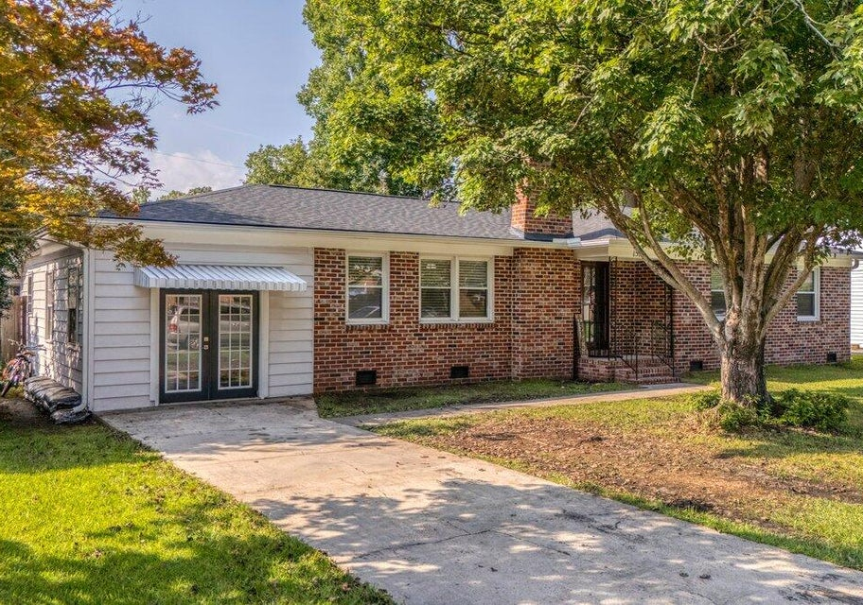
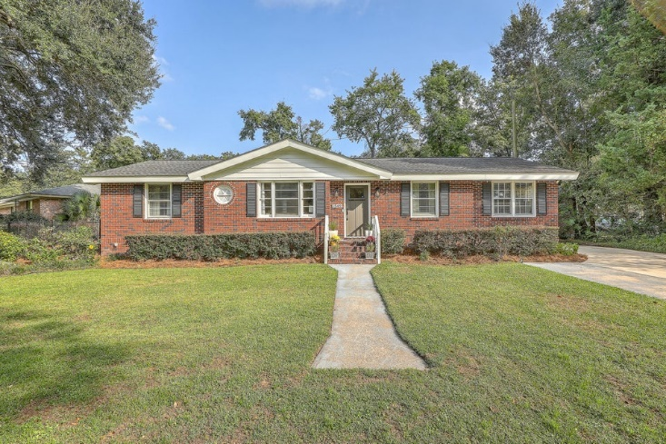
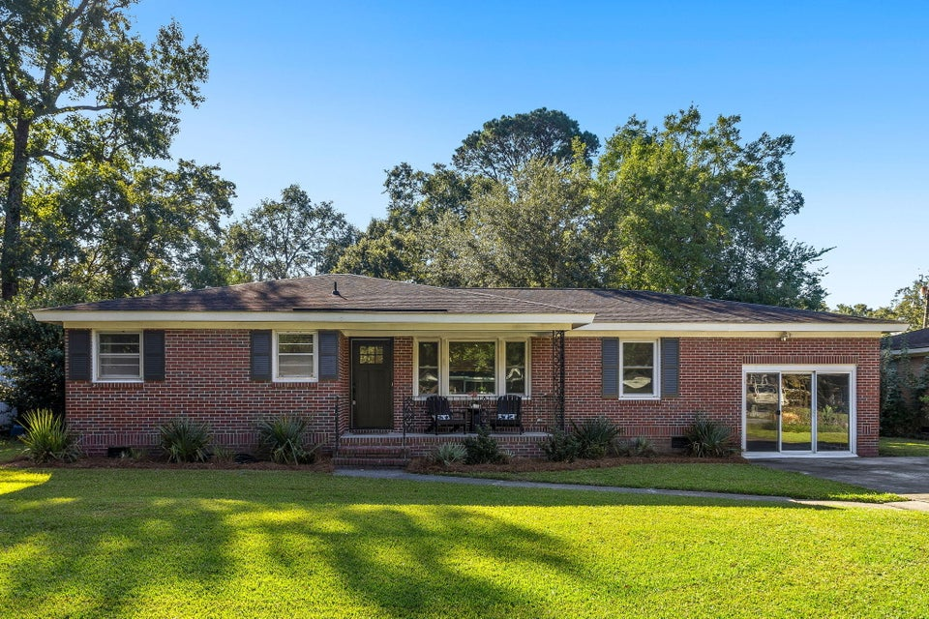
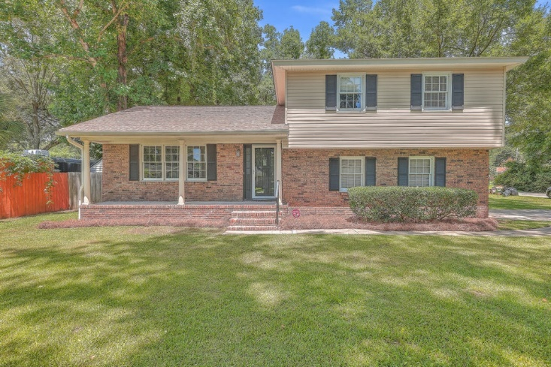
Ashley Hall Manor Tour of Homes
Saturday 10/12 12-3PM
1516 Birthright Street
MLS# 24024957
$649,900
Elissa Campbell
843-853-1433
elissa.campbell@agentownedrealty.com
AgentOwned Realty Preferred Group
Offering a $1500 Agent Bonus with Offer by 10/31
1549 Downing St
MLS# 24025964
$619,990
Scott Baskin
843-324-4139
scott@explorecharlestonrealestate.com
Keller Williams Realty Charleston West Ashley
1513 Salisbury St
MLS# 24025220
$599,000
Helene Barrett
843-422-4545
helene@thepulsecharleston.com
The Pulse Charleston
1636 Falmouth Street
MLS# 24026019
$534,990
Scott Baskin
843-324-4139
scott@explorecharlestonrealestate.com
Keller Williams Realty Charleston West Ashley
ALL HOMES OFFERING 2.5% BUYER AGENCY COMMISSION
Leave your card at each listing to be entered for a drawing for "Glass Onion" gift card!

