Slide 1


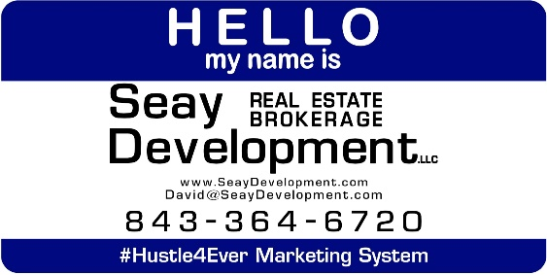
Mount Pleasant Auto Service
Undisclosed Address
Mt. Pleasant, South Carolina
BUSINESS OPPORTUNITY FOR SALE
A High Traffic Auto Service Center in Mt. Pleasant, South Carolina. This is a confidential Listing so please inquire for a Non-Disclosure. There is an existing lease and Landlord knows the business is for sale.
Catylist ID: | #29898674
Building Size (RSF): | See Agent
Sale Price: | $250,000
Property Subtypes: | Auto Related
Name of Establishment: | Confidential
Industry Segment: | Other Auto Related
Reason for Selling: | Lost interest in the industry.
County: | Charleston
Tax ID/APN: | Undisclosed
David H Seay
CCIM, BIC, CCIM, REALTOR
(843) 364-6720
david@seaydevelopment.com
Seay Development, LLC
3404-202A Salterbeck Street
Mt. Pleasant, SC 29466 www.seaydevelopment.com

