Slide 1


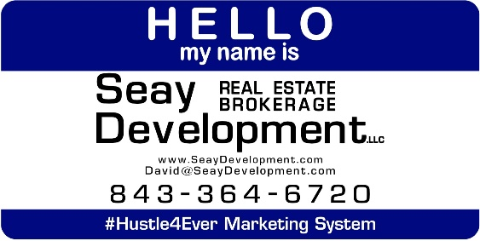
Automotive Repair & Service Business
Undisclosed Address
North Charleston, SC 29406
BUSINESS OPPORTUNITY FOR SALE
An established, family operated auto service repair and maintenance business that includes the business, furniture fixtures and equipment and a half acre piece of real estate that has a 4,000 square foot building on the property. The building is on the rear of the property so you could also deal autos or vehicle sales on this property. This is a confidential listing and a non-disclosure is necessary to see financial information or learn of the physical property location.
Catylist ID: | #30000396
Building Size (RSF): | 4,000 SF
Sale Price: | $750,000
Property Subtypes: | Auto Related, Machinery, Manufacturing, Transportation
Sale Terms: | Business and Real Estate must sell together.
Reason for Selling: | Retirement
County: | Charleston
Tax ID/APN: | Undisclosed
David H Seay
CCIM, BIC, CCIM, REALTOR
(843) 364-6720
david@seaydevelopment.com
Seay Development, LLC
3404-202A Salterbeck Street
Mt. Pleasant, SC 29466 www.seaydevelopment.com

