Slide 1
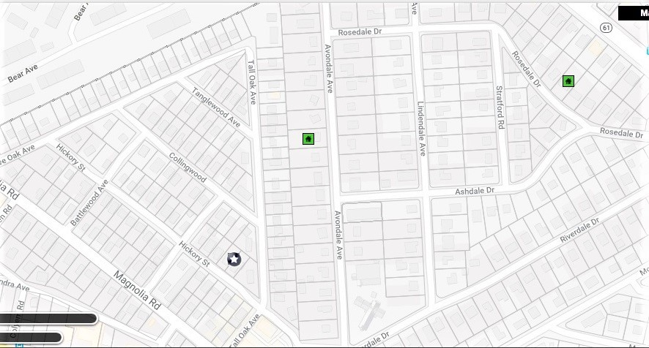
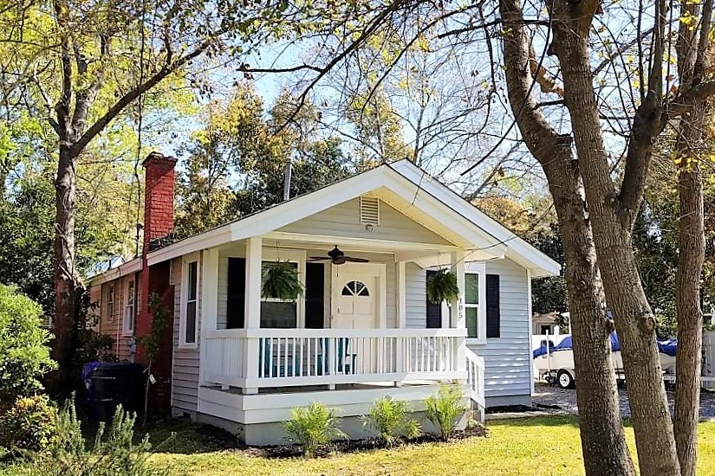
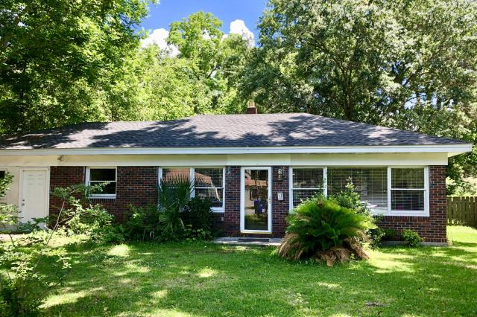
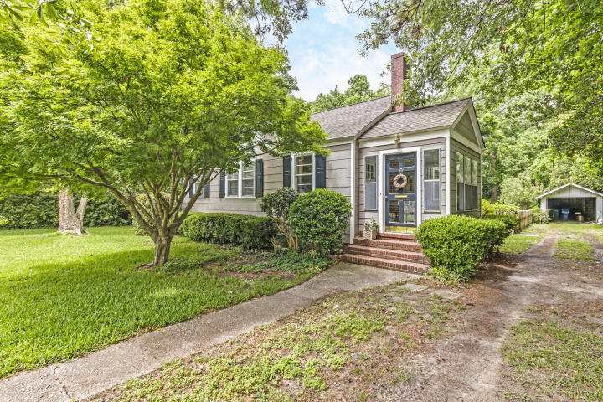
Avondale Neighborhood Agent Open House Friday 11:30-2:00
105 Hickory Street
MLS# 18007922
Behren Kittrell
843-870-3549
behrenk@scflatfeerealty.com
Charleston Flat Fee Real Estate
12 Rosedale Drive
MLS# 18014423
Mary Kathryn Nelson
843-694-8160
jaymemknoll@gmail.com
Carolina Elite Real Estate
29 Avondale Avenue
MLS# 18013971
Barbara Brown
843-324-7787
babrown.realty@gmail.com
Barbara Brown Real Estate

