Slide 1
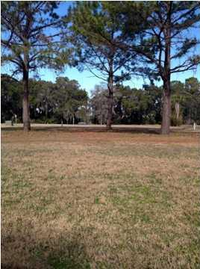
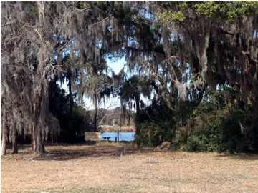
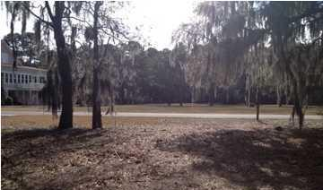
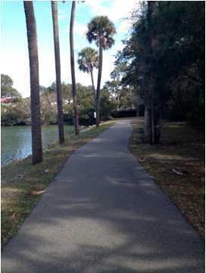
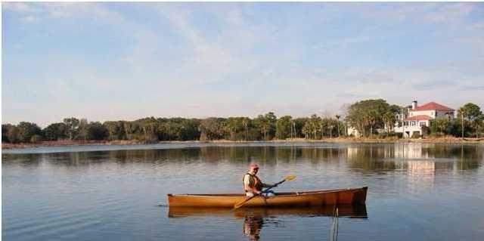
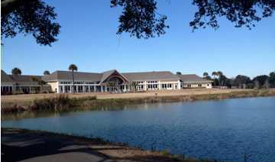


Fantastic Investment Opportunity for Island Living!!
B-8 Seabrook Village Drive
The Village at Seabrook | Seabrook Island, SC 29455 | MLS# 15005838 | $189,000
This is your chance to own a piece of paradise on Lake Palmetto at Seabrook Island. The Village at Seabrook boasts a neighborly feel and cottage style homes reminiscent of old Charleston. From this beautiful home site you can enjoy fabulous sunsets over the lake, kayaking right out your back door, and many walking and jogging trails.
You are also walking distance to the fabulous lake house with indoor and outdoor pools, fitness center, library and so much more. A short bike ride will take you to Fresh Fields Village, the Racquet Club or the Equestrian Center. Come take a look at this great opportunity and all it has to offer today!
Contribution to capital within P.U.D. Upon the initial sale and resale is 1/2 of 1% of the sale price. Purchase also requires membership to the Club at Seabrook.
Patricia Lehman Byrne
Mobile - (973) 868-1039 Patricia@kwluxuryhomes.com
luxurypropertiesincharleston.com
Keller Williams Realty Charleston West Ashley
1180 Sam Rittenberg Ste 105
Charleston, SC 29407

