Slide 1

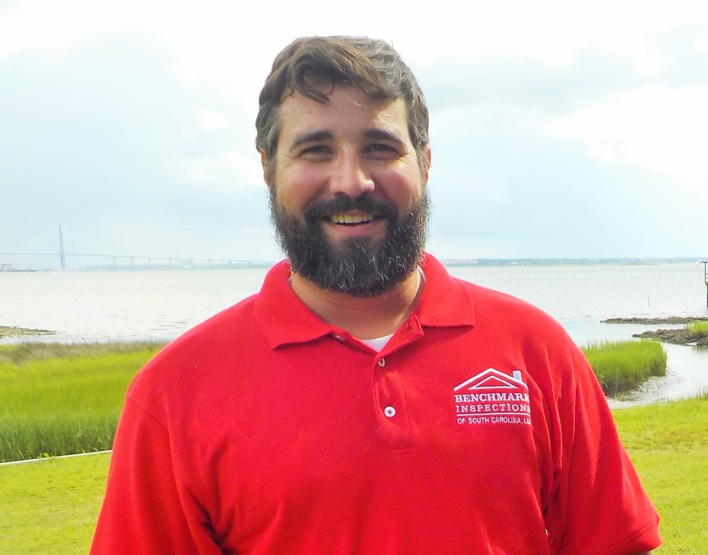



Win A Dinner For Two At Grace & Grit Restaurant
Benchmark Inspections
of South Carolina is expanding
To celebrate, we’re hosting a giveaway for a
$100 gift certificate to Grace & Grit Restaurant.
We have always been proud to be a small, locally owned company and we pride ourselves on giving our clients a personal experience. However, thanks to all of the realtors & clients that have been so kind to depend on us and recommend us to others, we had reached a point of not being able to accommodate all of those who called us.
So we are now happy to announce the addition of Steven Wolfe to our team. Steven was born & raised right here in the Lowcountry and he is excited to put his talents, knowledge, and enthusiasm to work for you!
Our growing team gives you one more reason you can count on Benchmark Inspections of SC to give you the peace of mind of knowing that you’ve had the best home inspection possible!
Steven Wolfe
InterNACHI-Certified
SC License # 49277
REGISTER TO WIN A $100 GIFT CERTIFICATE TO GRACE & GRIT RESTAURANT
Grace & Grit exemplifies the best of our home here in the Lowcountry
with their southern cuisine & locally sourced seafood.
To enter:
Like & follow our Facebook page at www.facebook.com/BenchmarkInspectionsSC
Tag a friend who would enjoy joining you in the comments.
You may enter more than once in separate comments. Winner announced on 8/20/18
BENCHMARK INSPECTIONS OF SOUTH CAROLINA, LLC
915 Royall Ave
Mount Pleasant, SC 29464
843-801-8868
www.BenchmarkInspectionsSC.com
John Boensch, CPI
InterNACHI-Certified
SC License # 439

