Slide 1
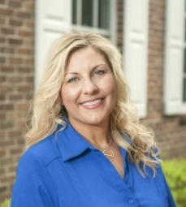
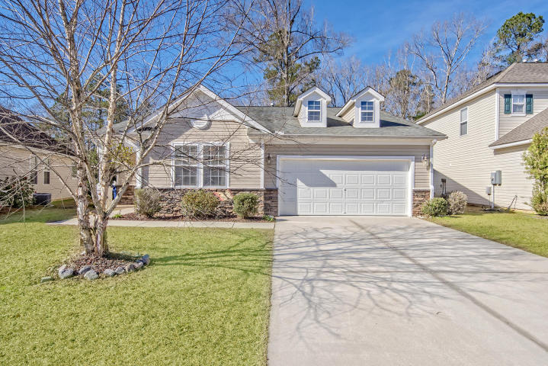

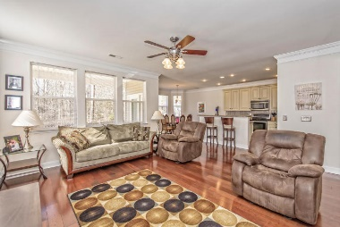
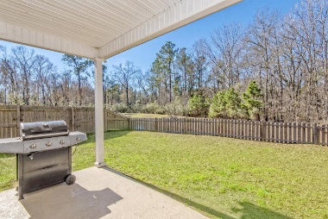


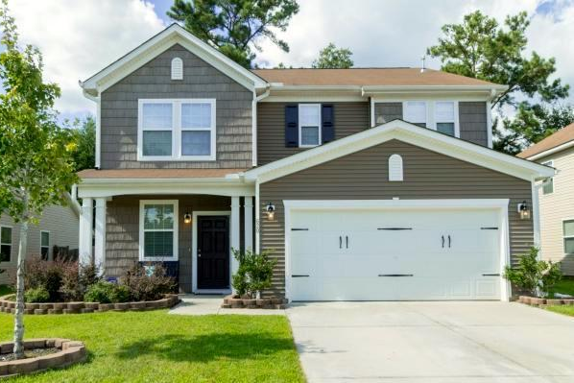
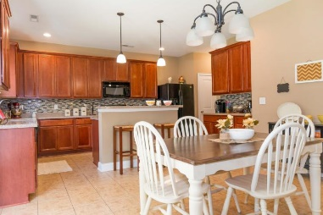
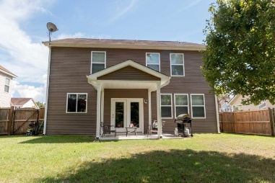

Beth Mandell
M 843-900-1296
bmandell@century21properties.com
www.bestcarolinahomedeals.com
Reba Cole
M (843) 819-7322
rcole@century21properties.com www.century21properties.com
Blackberry Creek Open House - Sunday from 1-4
660 Grassy Hill Road
MLS# 17002281
$224,900
3 Bedrooms
2 Baths
2,287 Square Feet
View a tour of this home at http://zyndicate.co/660Grassy-branded.html
Come join us on Sunday, February 12th to tour, not one, but two stunning homes in Blackberry Creek!
Both homes boast 3 bedrooms plus a Bonus Room. Both are move in ready. All that's missing is your family!
You will fall in love with these beautiful homes!
620 Grassy Hill Road
MLS# 16022203
$229,900
3 Bedrooms
2½ Baths
2,276 Square Feet
Century 21 Properties Plus | 118 W Richardson Ave | Summerville, SC 29483

