Slide 1
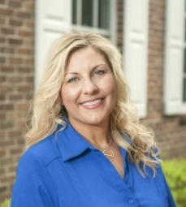
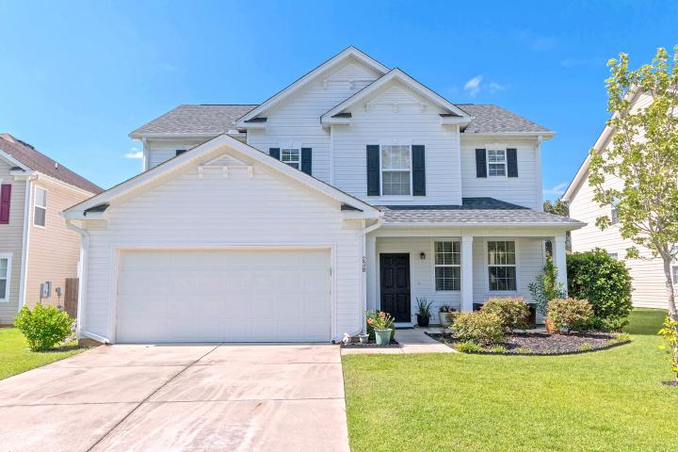
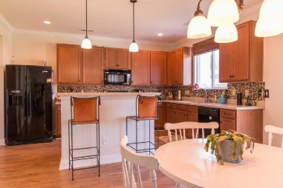
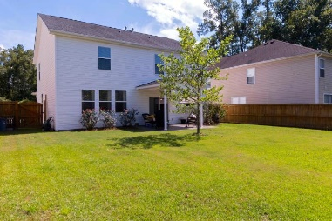
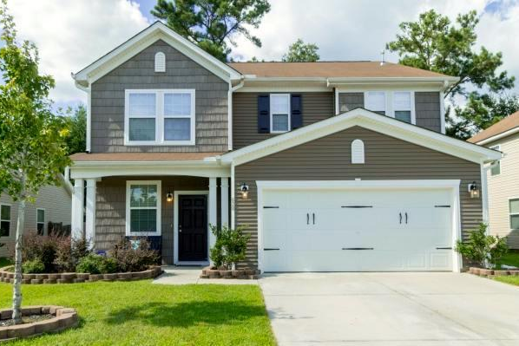
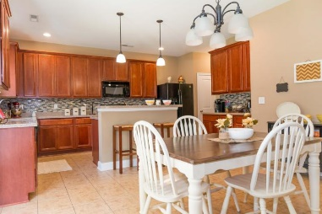
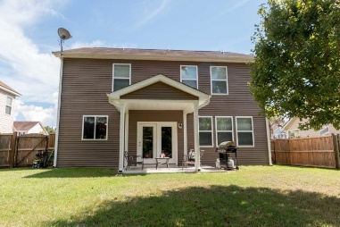
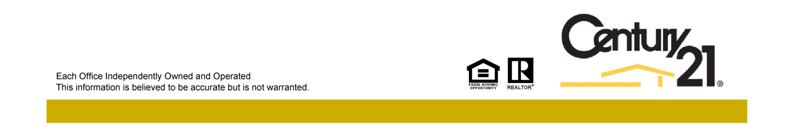
Reba Cole
M (843) 819-7322
rcole@century21properties.com
www.century21properties.com
Blackberry Creek Open Houses - Sunday from 1-5
238 Austin Creek Court
MLS# 16022902
$247,000
3 Bedrooms
2½ Baths
2,614 Square Feet
Come join us on Sunday, September 4th to tour, not one, but two stunning homes in Blackberry Creek! Both homes boast 3 bedrooms and 2.5 bathrooms. Both are fully functional and move in ready, all that's missing is your family! From 1pm - 3pm we will be showing the picturesque home of 238 Austin Creek Court. With the flowing floor plan , neutral wall color, and beautiful Pergo wood floors, it is perfect for any event from family night to entertaining parties. This home is truly a must see! Afterward, pop around the corner to 620 Grassy Hill Road from 3pm - 5pm. As you walk through you will spot all of the beautiful touches that this home has to offer, from granite counter tops to custom tile back splash. You won't want to miss this charming home!
620 Grassy Hill Road
MLS# 16022203
$239,100
3 Bedrooms
2½ Baths
2,276 Square Feet
Century 21 Properties Plus | 3301 Salterbeck St Suite 100 | Mt. Pleasant, SC 29466

