Slide 1
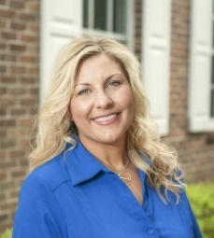
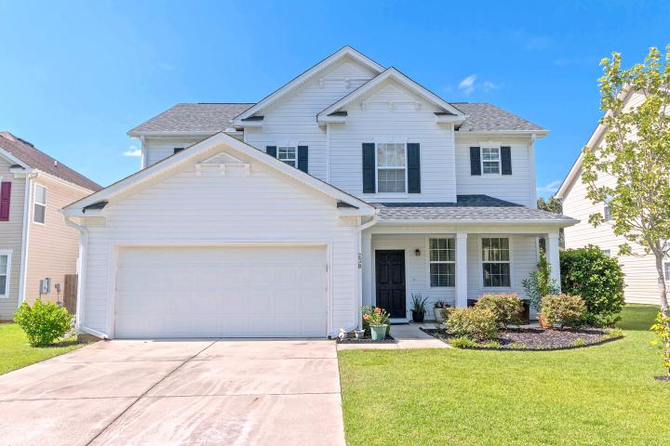
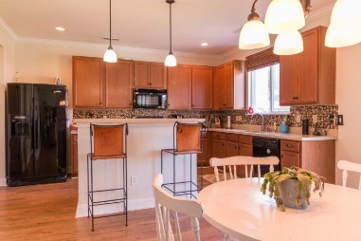
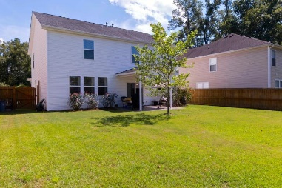
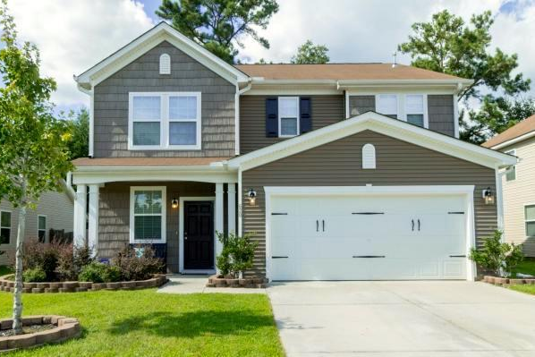
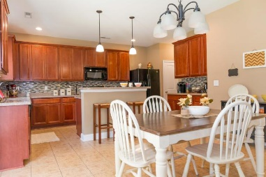
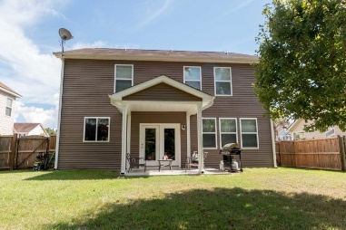
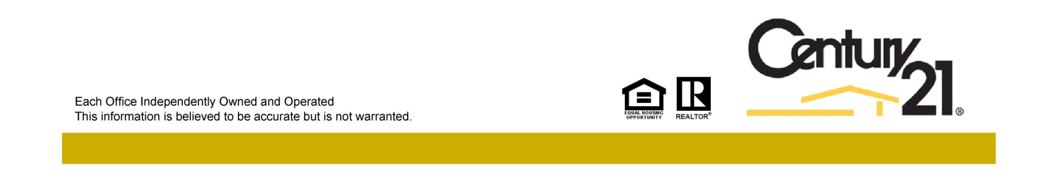
Reba Cole
M (843) 819-7322
rcole@century21properties.com
www.century21properties.com
Blackberry Creek Open Houses - Wednesday from 11:30-1:30
238 Austin Creek Court
MLS# 16022902
$246,500
3 Bedrooms
2½ Baths
2,614 Square Feet
Come join us on Wednesday, September 28th to tour, not one, but two stunning homes in Blackberry Creek! Both homes boast 3 bedrooms and 2.5 bathrooms. Both are fully functional and move in ready, all that's missing is your family!
With the flowing floor plan, neutral wall color, and beautiful Pergo wood floors, 238 Austin Creek Court is perfect for any event from family night to entertaining parties. This home is truly a must see!
Afterward, pop around the corner to 620 Grassy Hill Road. As you walk through you will spot all of the beautiful touches that this home has to offer, from granite counter tops to custom tile back splash. You won't want to miss this charming home!
Agents who visit both homes will be entered to win a $100 Visa Gift Card. Lunch and dessert will be provided.
620 Grassy Hill Road
MLS# 16022203
$238,000
3 Bedrooms
2½ Baths
2,276 Square Feet
Century 21 Properties Plus | 3301 Salterbeck St Suite 100 | Mt. Pleasant, SC 29466

