Slide 1
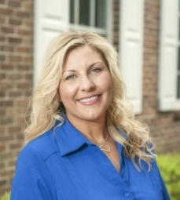
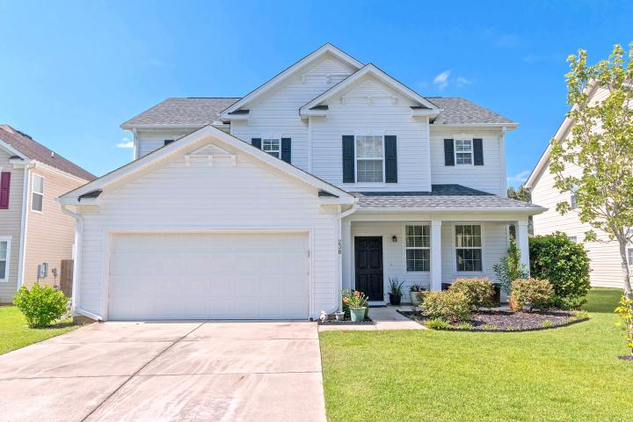
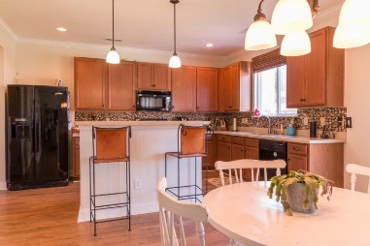
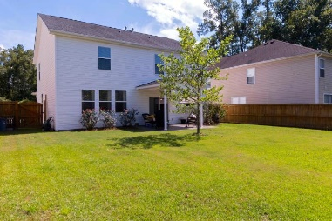
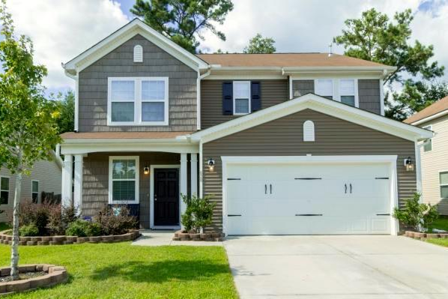
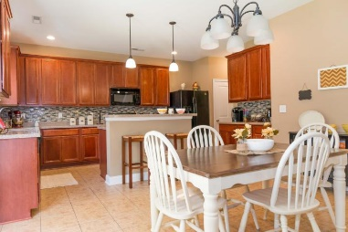
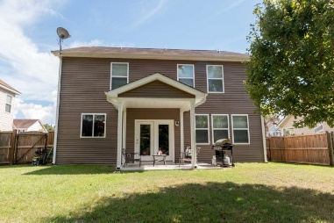
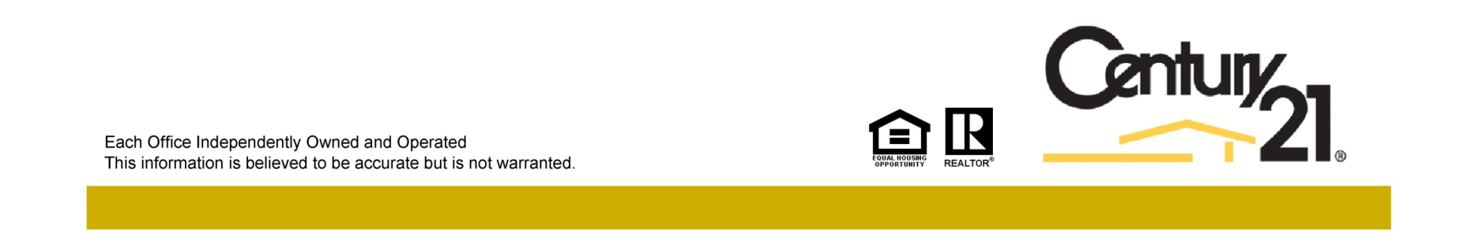
Two Beautiful Homes… One Great Neighborhood
Reba Cole
M (843) 819-7322
rcole@century21properties.com www.century21properties.com
Welcome to Blackberry Creek
238 Austin Creek Court
MLS# 16022902
$247,000
3 Bedrooms
2½ Baths
2,614 Square Feet
Both of these homes boast 3 bedrooms and 2.5 bathrooms. Both are fully functional and move in ready…all that's missing is your family!
238 Austin Creek Court With the flowing floor plan, neutral wall color, and beautiful Pergo wood floors, it is perfect for any event from family night to entertaining parties. This home is truly a must see!
620 Grassy Hill Road As you walk through you will spot all of the beautiful touches that this home has to offer, from granite counter tops to custom tile back splash. You won't want to miss this charming home!
620 Grassy Hill Road
MLS# 16022203
$239,100
3 Bedrooms
2½ Baths
2,276 Square Feet
Century 21 Properties Plus | 3301 Salterbeck St Suite 100 | Mt. Pleasant, SC 29466

