Slide 1
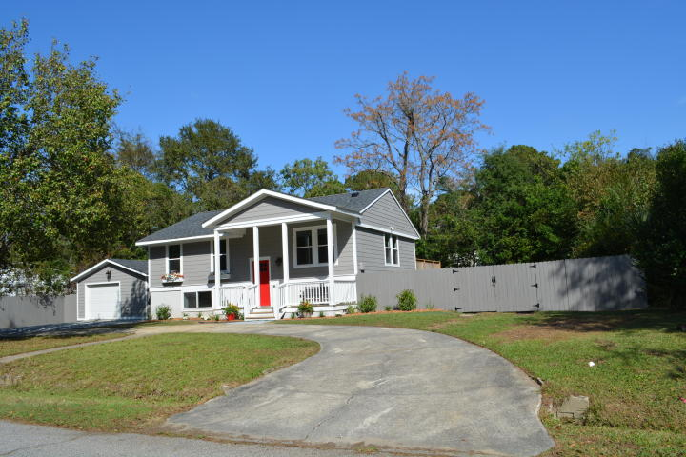
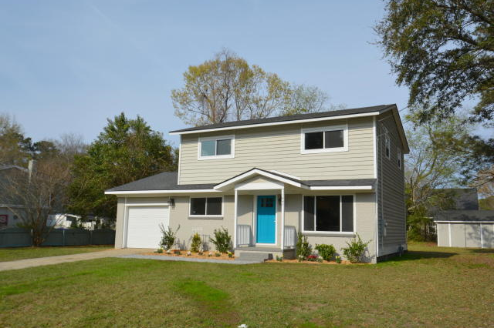
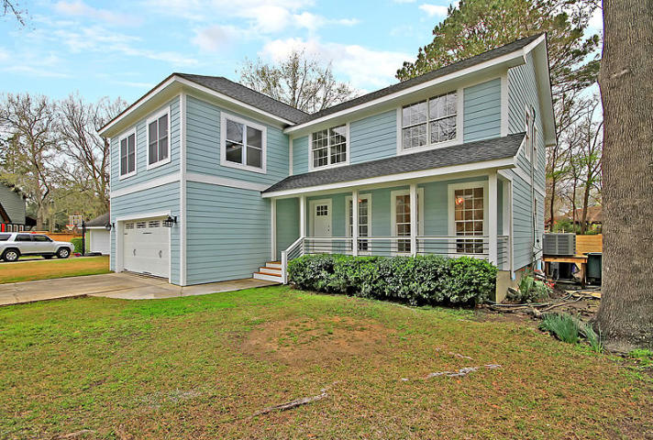
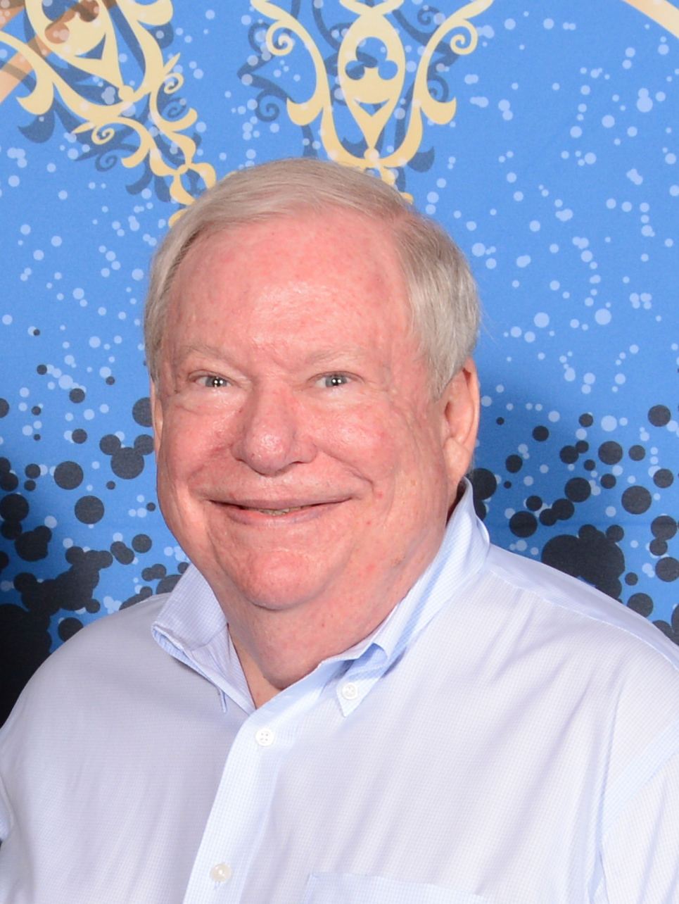

Come See Three Open Houses Sunday, April 7th from 1-4
1843 Debbenshire Drive
West Ashley Plantation
Charleston, SC 29407
MLS# 18030860
$346,500
Hosted by Keith E. Flatt
843-513-6604
KeithFlatt222@gmail.com
Buy.......Build.....Begin
1847 Sandcroft Drive
West Ashley Plantation
Charleston, SC 29407
MLS# 19007399
$335,000
Hosted by Mark Goldsmith
843-743-4177
markgoldsmith@kw.com
1928 Madagascar Court
Springfield
Charleston, SC 29407
MLS# 19007584
$565,000
Hosted by Winnie Timmons
410-960-1648
timmonswinnie@gmail.com
Bob Ramella, Broker
CRS, CDPE, RCC, e-Pro
(843) 330-8300
bob@bobramella.com | bobramella.kw.com
Keller Williams Realty Charleston | 496 Bramson Ct Ste 200 | Mt. Pleasant, SC 29464

