Slide 1
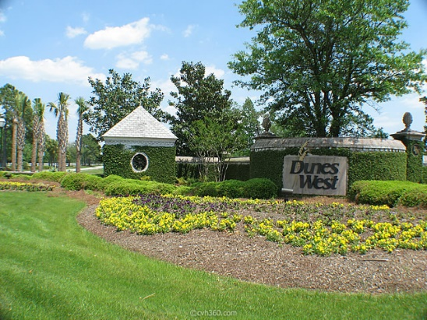
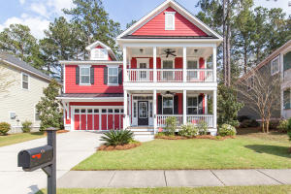
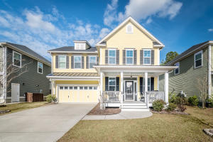
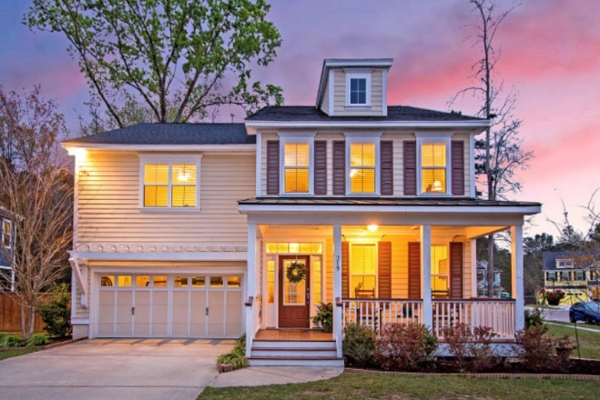
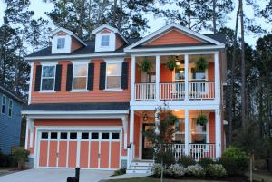
Branch Creek Open House Tour
Saturday, April 20th from 1-4
420 Brick Kiln Drive
MLS# 19009011
$405,000
Chad Priest
843-557-5748
chad@rogcharleston.com
Realty One Group Coastal
323 Brick Kiln Drive
MLS# 19004036
$345,000
Chris Armstrong
843-813-3977
armstrong986@gmail.com
Maven Realty
Refreshments will be served!
319 Brick Kiln Drive
MLS# 19008682
$415,000
Christopher Smith
843-267-0735
christopher@mattoneillteam.com
Matt O'Neill Real Estate
126 Evelyn Joy Drive
MLS# 19007850
$339,995
Margaux Kilgallen
843-670-4035
mak@beresfordrealty.com
Beresford Realty
** Agents: please plan to show your pocket card at the gate **

