Slide 1
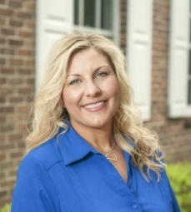
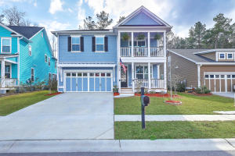


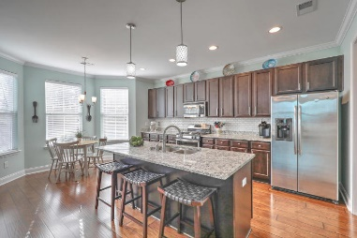
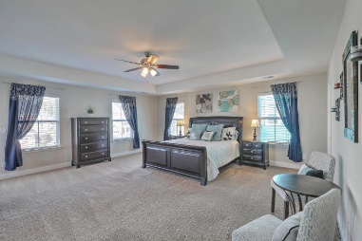

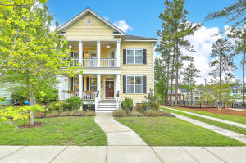
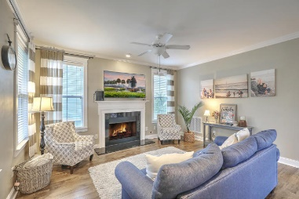
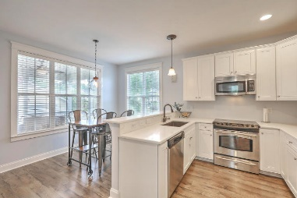

Reba Cole
M (843) 819-7322
rcole@century21properties.com www.century21properties.com
Andy Green
M 843-276-8512
agreen@century21properties.com www. andygreenrealestate.com
Branch Creek Open House - Saturday from 1-3
110 Evelyn Joy Drive
MLS# 18004878
$304,900
3 Bedrooms
2½ Baths
2,406 Square Feet
View a tour of this home at http://zyndicate.co/660Grassy-branded.html
Come join us on Saturday, April 28th to tour, not one, but two stunning homes in Branch Creek!
Both homes boast 3 bedrooms. Both are move in ready. All that's missing is your family!
You will fall in love with these beautiful homes!
315 Branch Creek Trail MLS# 18010169
$265,000
3 Bedrooms
2½ Baths
1,916 Square Feet
Century 21 Properties Plus | 118 W Richardson Ave | Summerville, SC 29483

