Slide 1
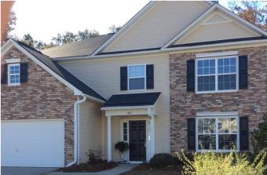
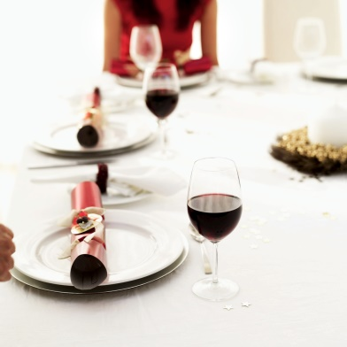
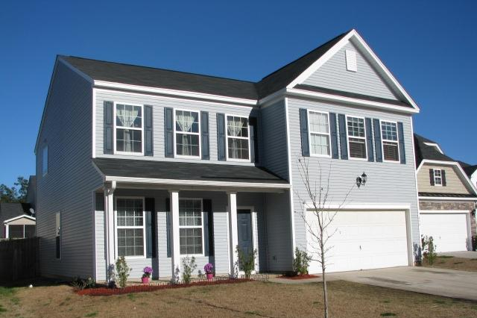
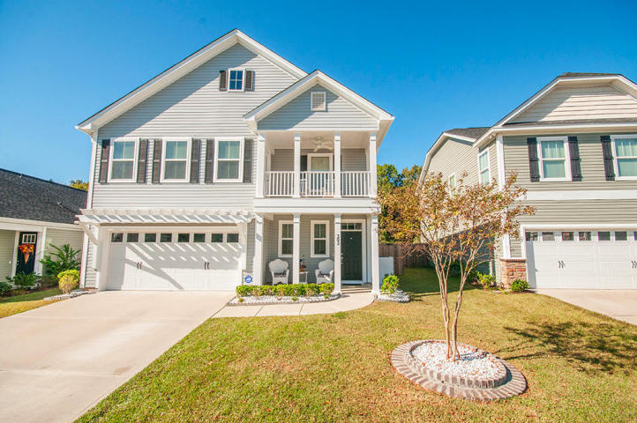

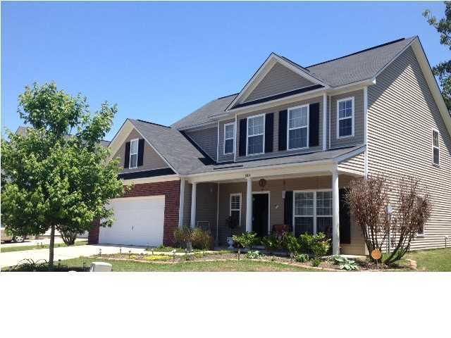
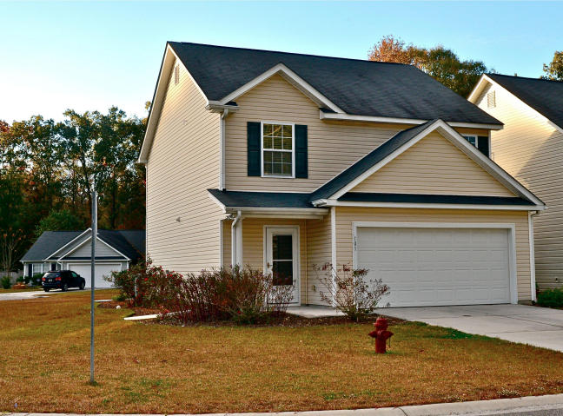
Brickhope Greens Holiday Open House
Wednesday, December 17th, 11:30am-1:30pm
Appetizer & Surprise Gift from Santa
Appetizer
457 Green Park Ln
MLS# 14029827 - $239,500
Lauree Bradway
Lauree Bradway & Assoc
843-814-4663
lb@lowcountryliving.com
454 Green Park Ln
MLS# 14028416 - $200,000
Kathy Tatum
Century 21 Properties Plus
843-860-3031
ktatum@century21properties.com
Lunch
303 Foster Greens Court
MLS# 14028732 - $245,000
Beth Mandell
Century 21 Properties Plus
843-900-1296
bmandell@century21properties.com
Dessert & $25 Visa Card
$25 Gift Card
320 Brickhope Ln
MLS# 1412277 - $217,000
Cristin Davis / Elizabeth Rivers
Carolina One Real Estate
843-270-3763 / 843-343-7549
cdavis@carolinaone.com
lrivers@carolinaone.com
101 Lovette Ct
MLS# 14029303 - $162,500
Corbett Thomas
Tin Roof Properties
843-327-0987
corbettcthomas@gmail.com
Must visit all 5 homes and leave your business card to qualify for the drawings.

